Slide 1
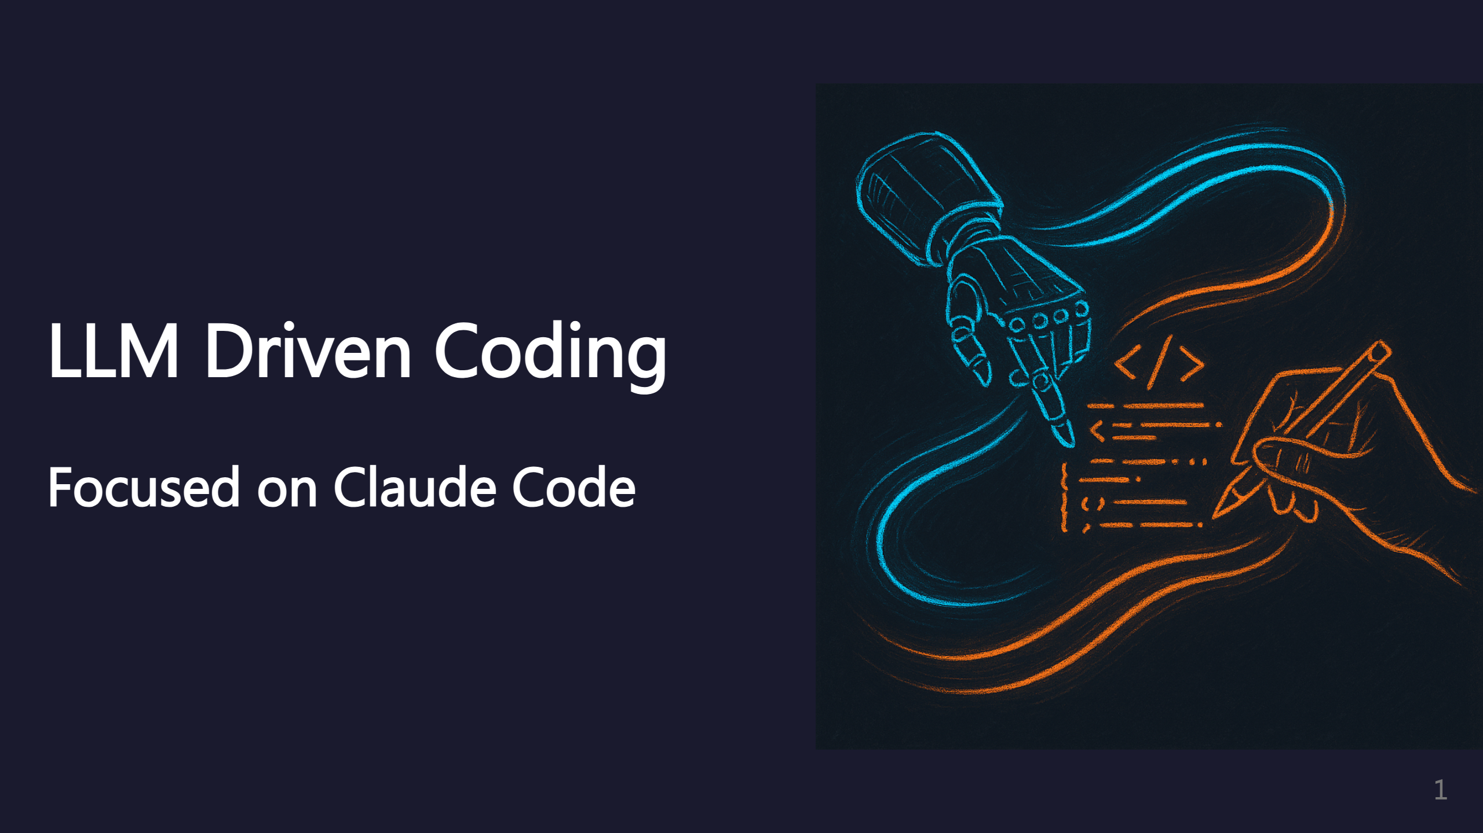
Notes:
This presentation covers LLM-driven coding practices, focused on Claude Code. Many of these ideas apply to other AI coding agents too. _transition: push

Slide 2
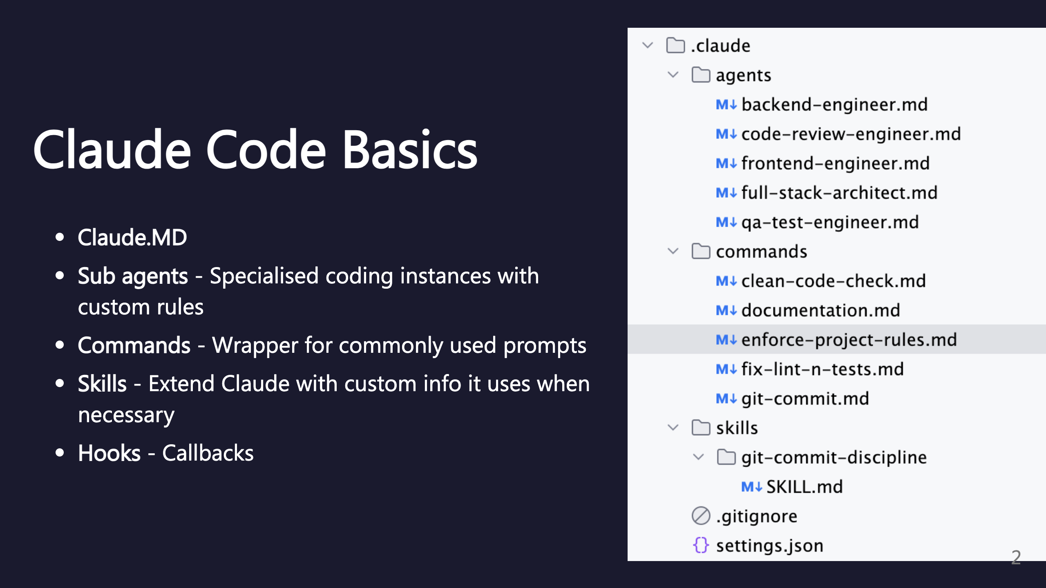
Notes:
Core components of Claude Code.

Slide 3
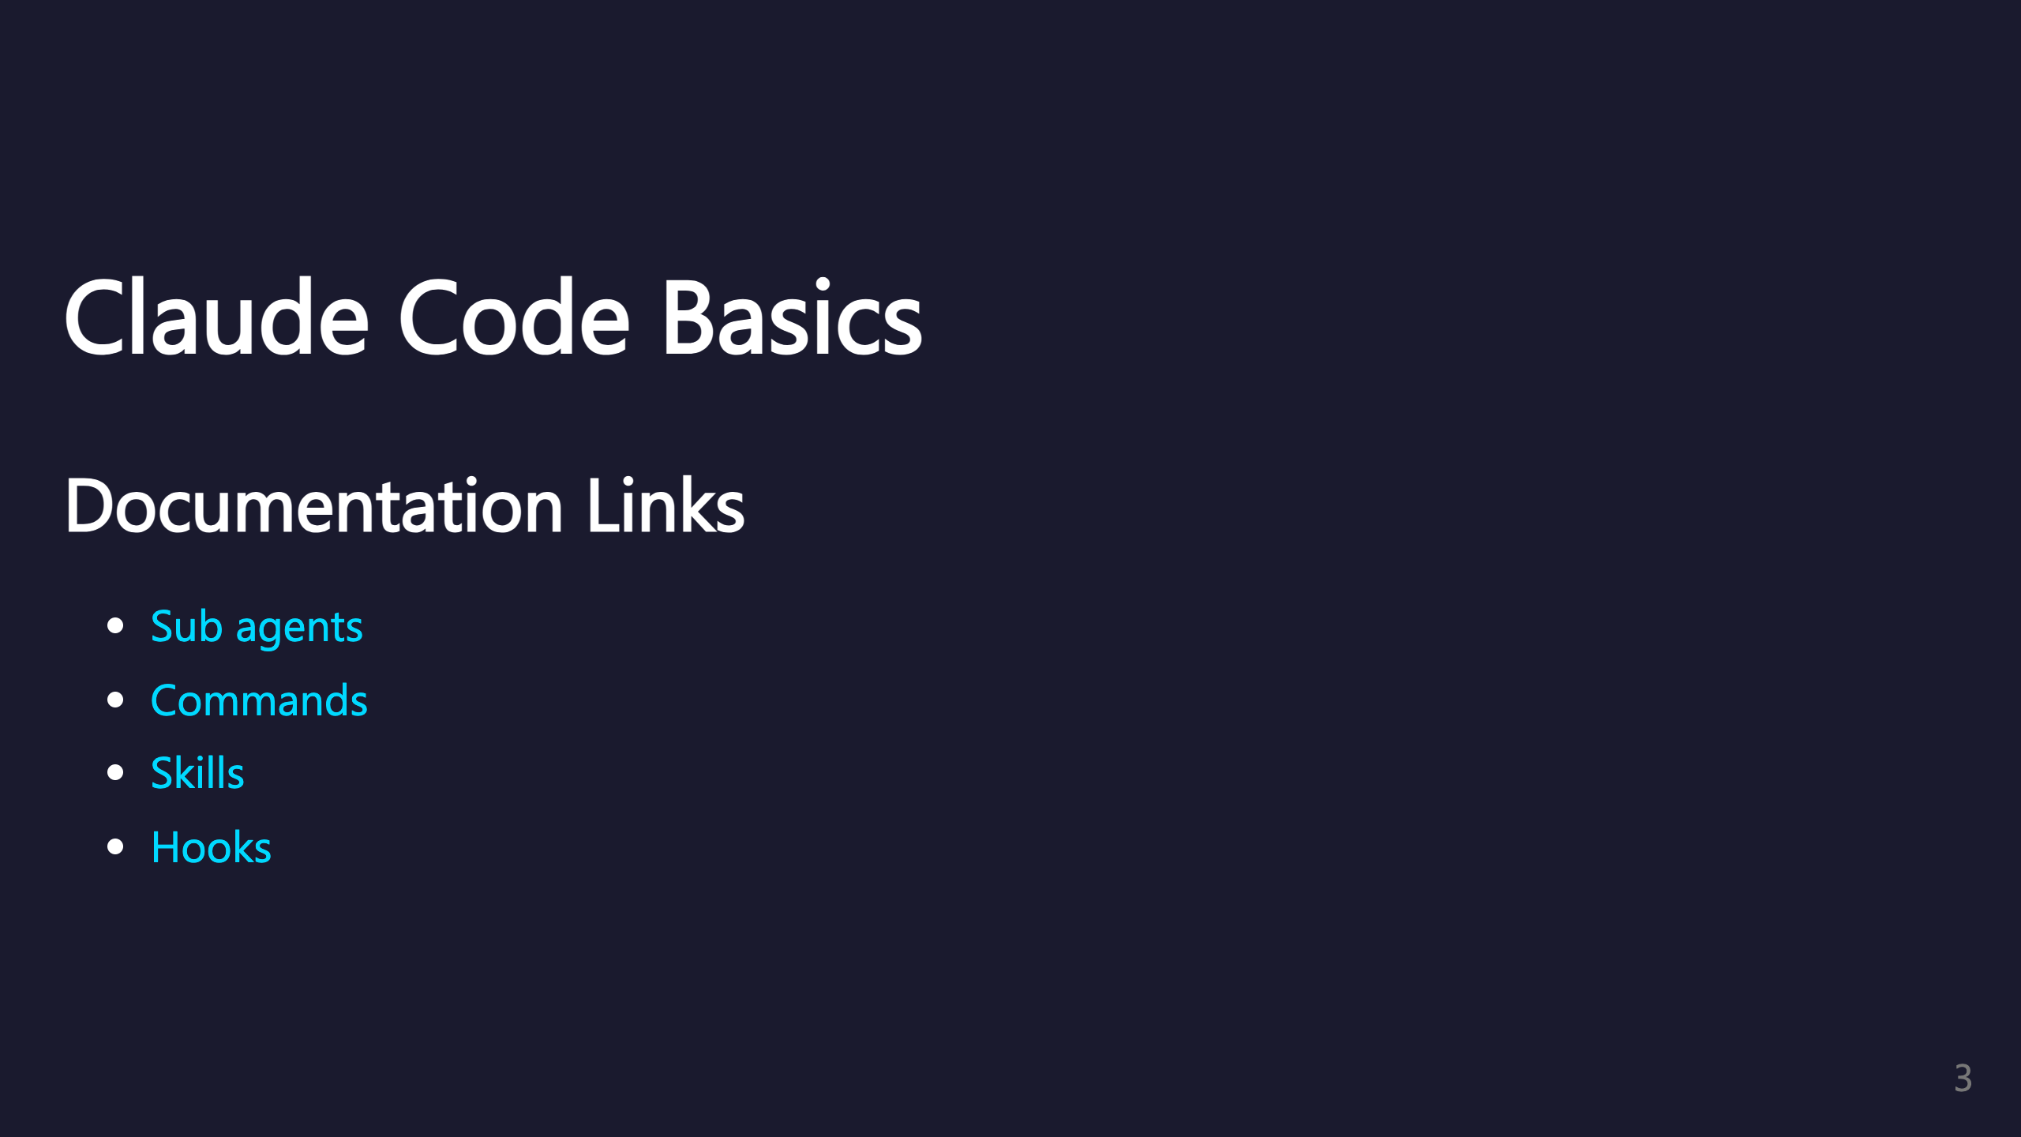
Notes:
All the official documentation links for Claude Code features. _transition: push

Slide 4
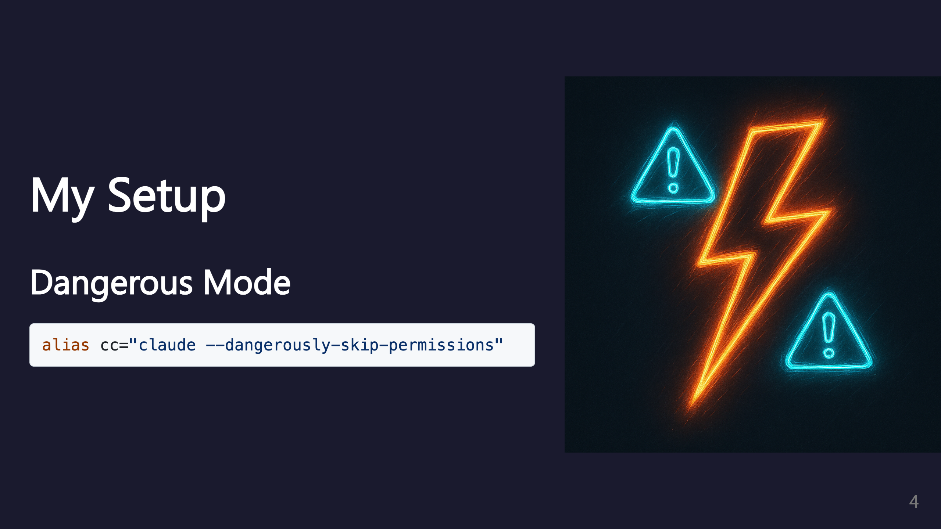
Notes:
Dangerous mode skips permission prompts for faster iteration. Use with caution - only in trusted environments.

Slide 5
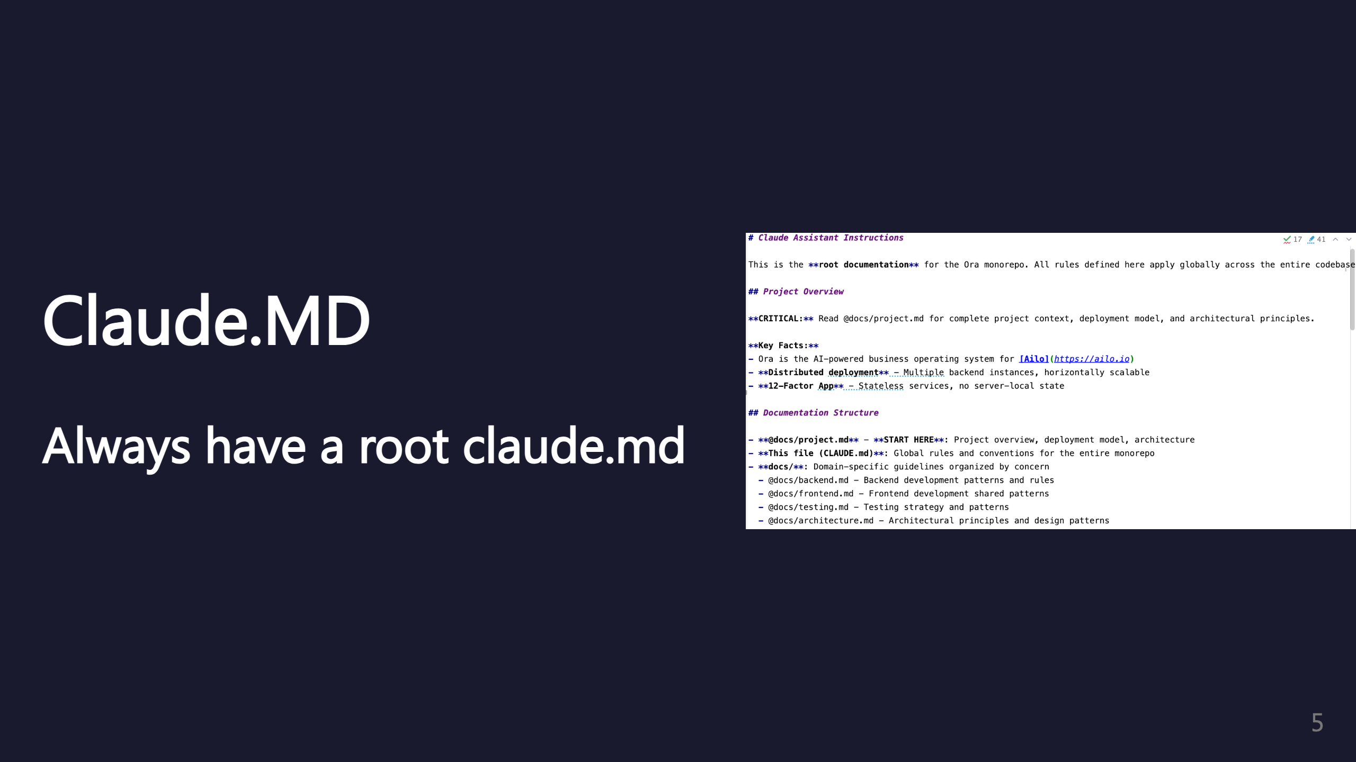
Notes:
The root Claude.MD file is essential for project context.

Slide 6
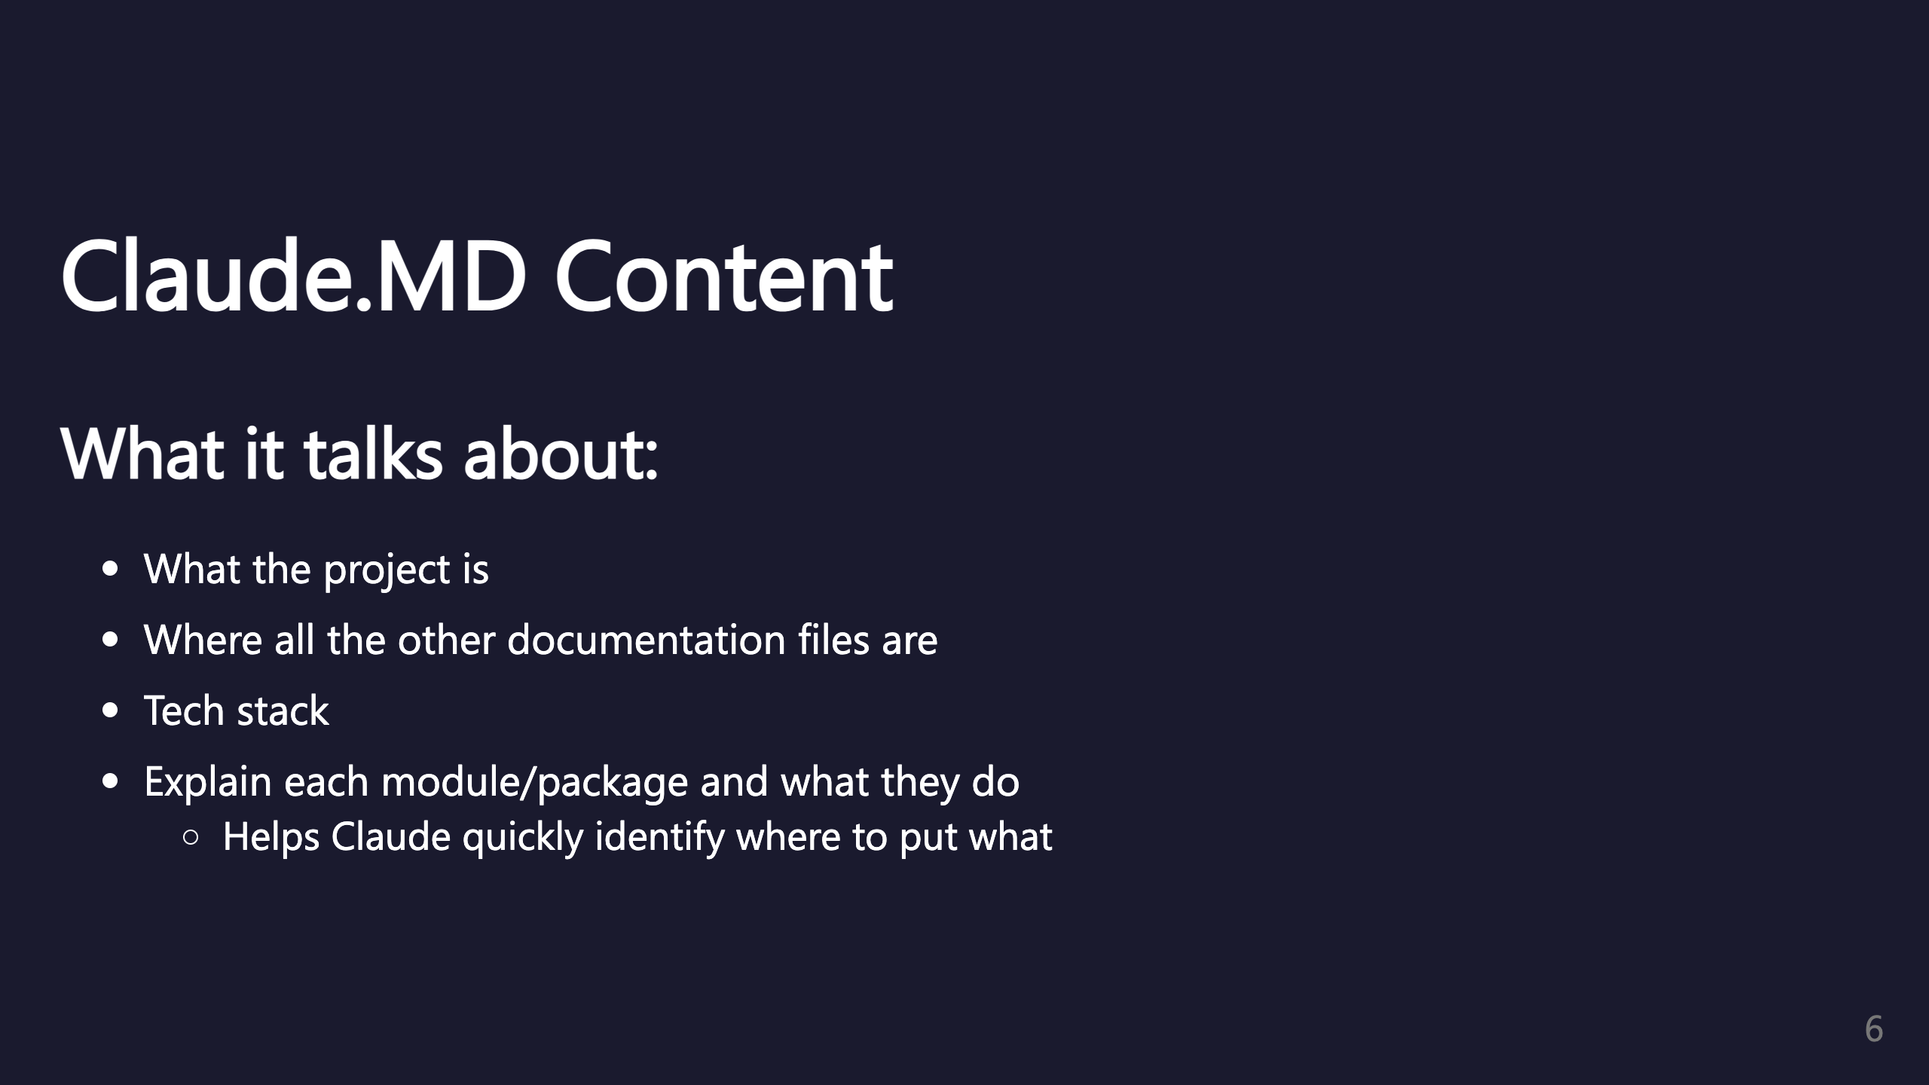
Notes:
Key sections to include in your Claude.MD file. Module explanations help Claude understand your codebase structure.

Slide 7
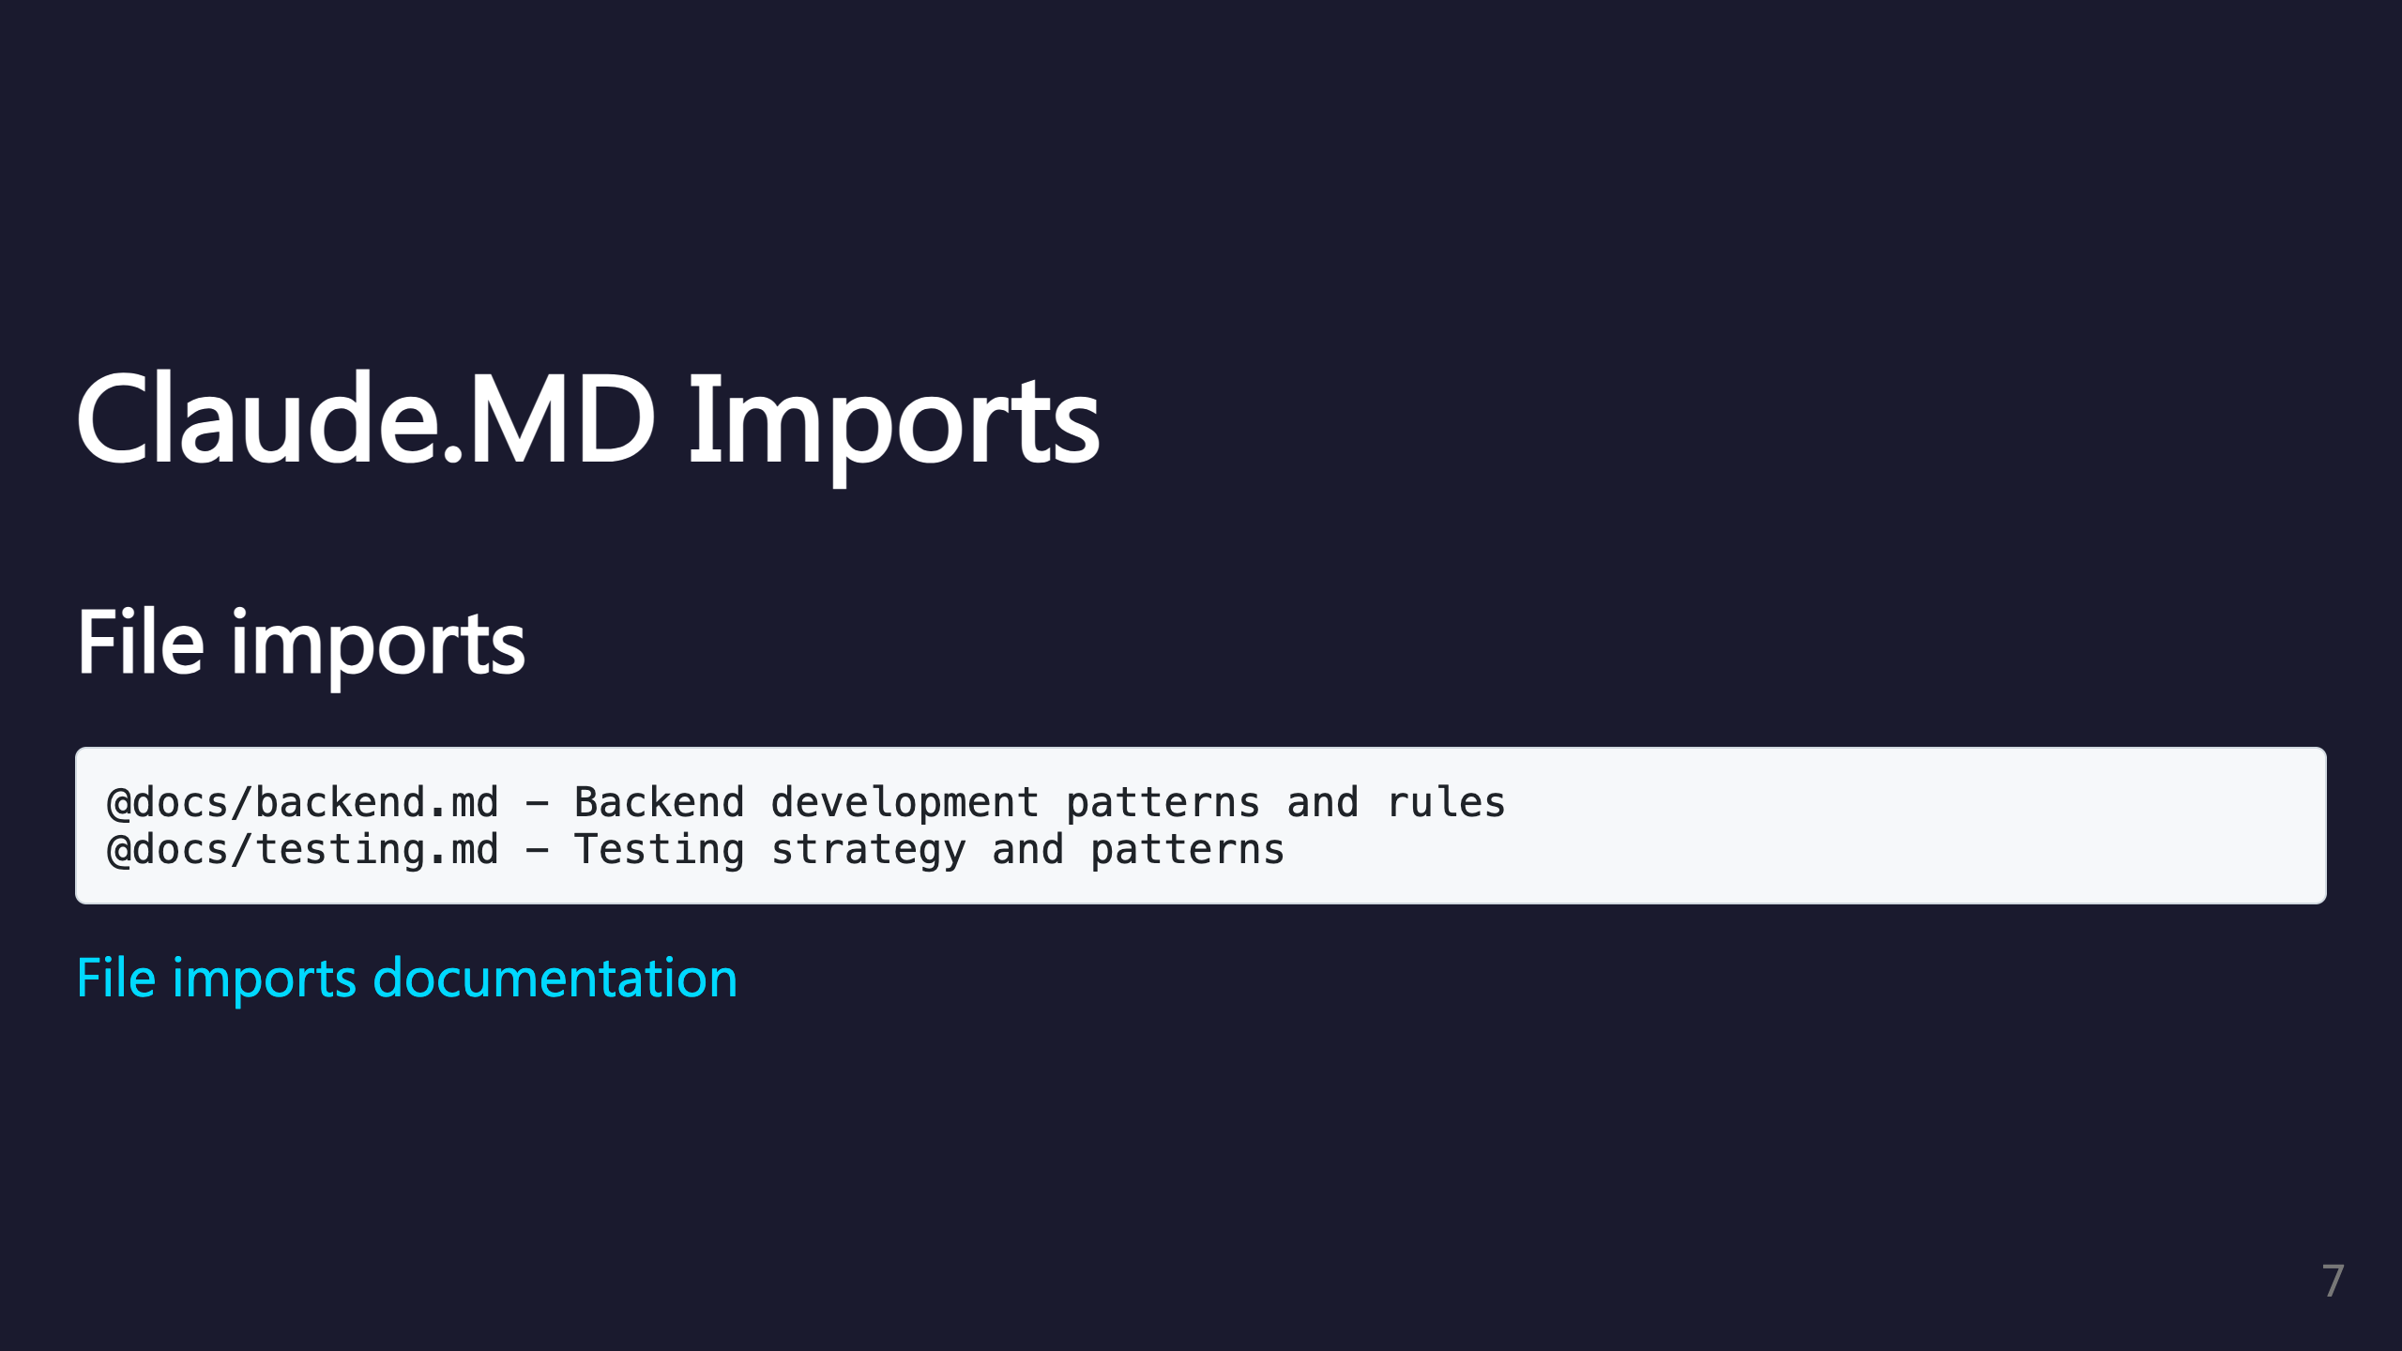
Notes:
Use file imports to organize documentation. Keep docs modular and focused.

Slide 8
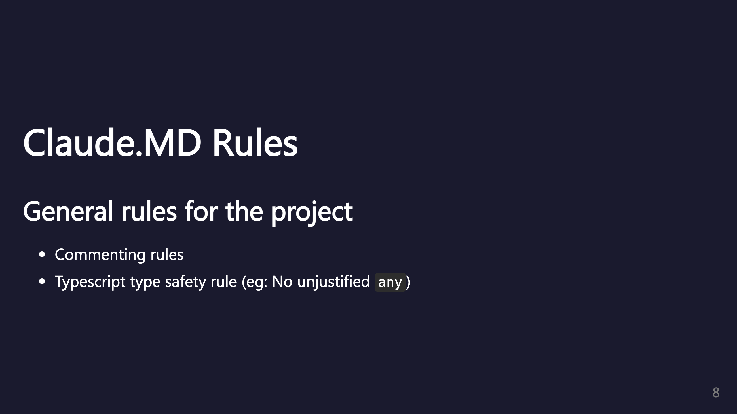
Notes:
Define project-wide rules in Claude.MD. Be specific about what's allowed and what isn't.

Slide 9
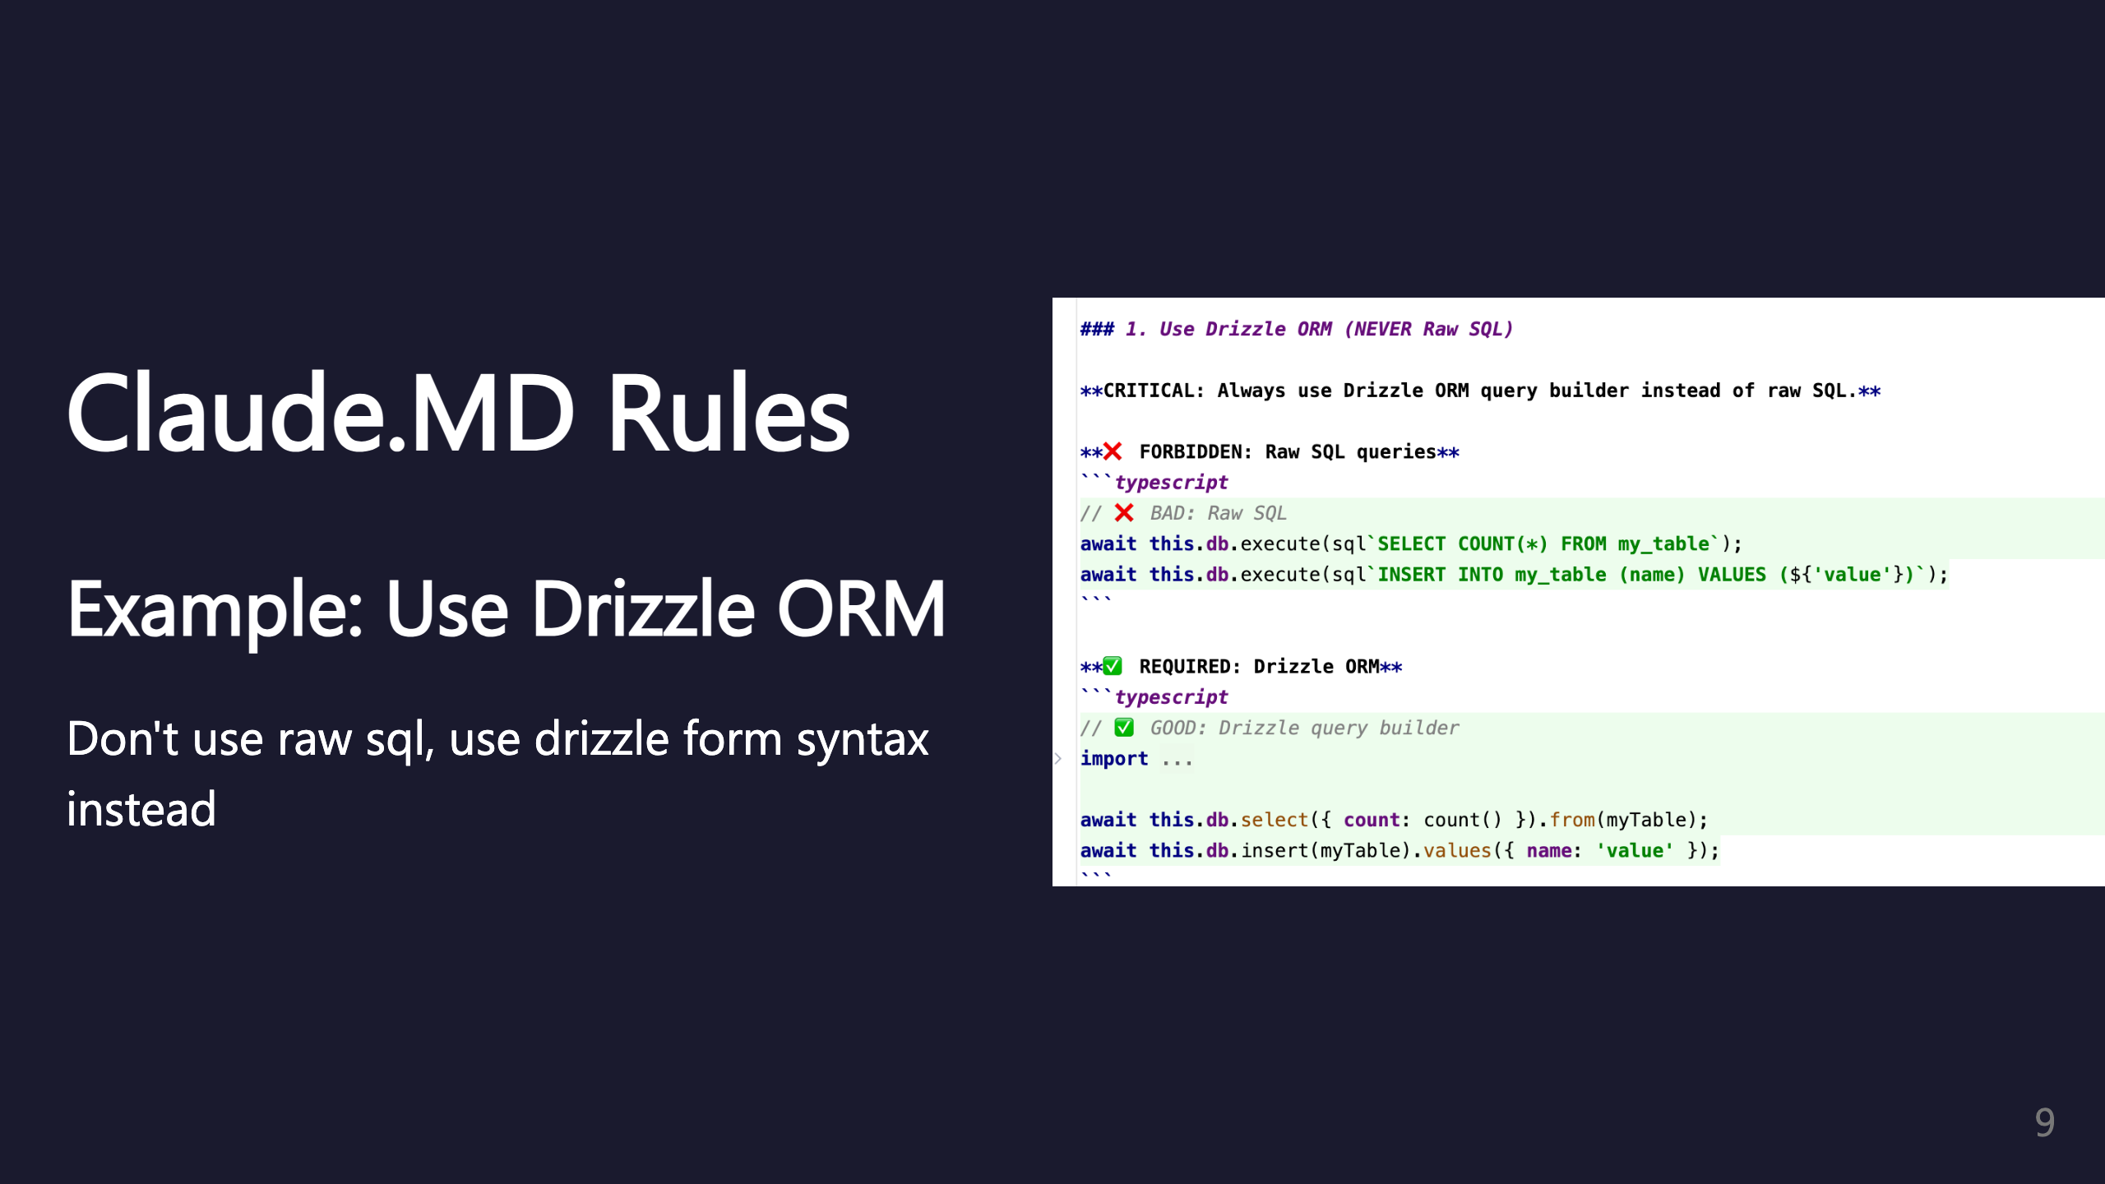
Notes:
Rule example: Enforce ORM usage over raw SQL.

Slide 10
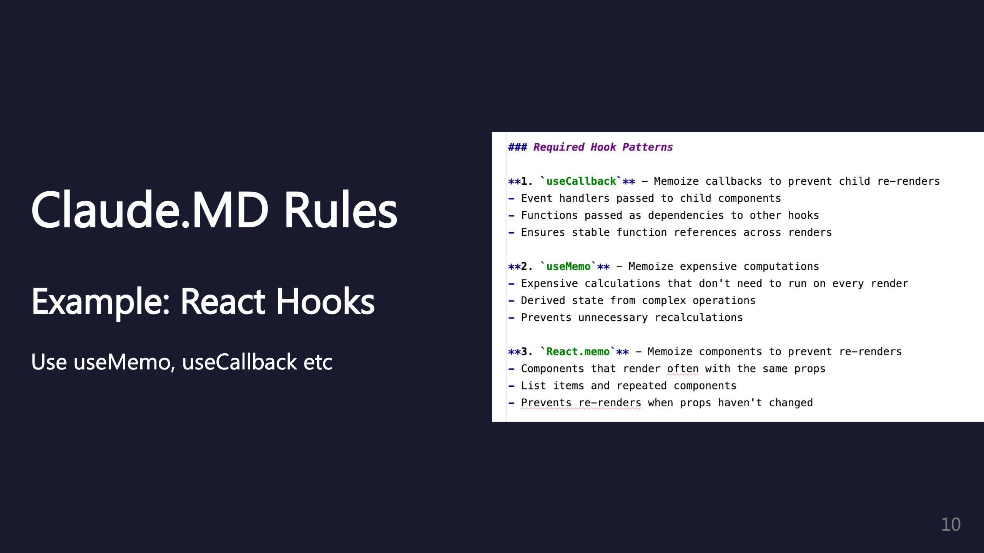
Notes:
Rule example: Enforce proper React hook usage.

Slide 11
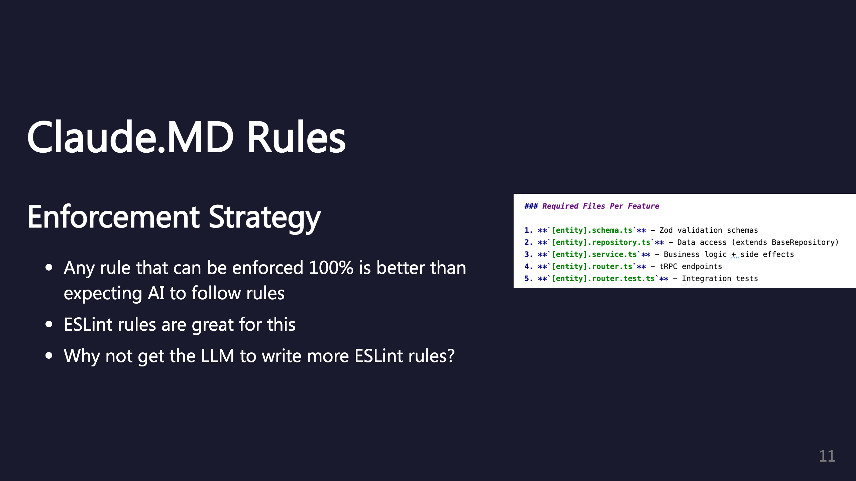
Notes:
Key insight: Programmatic enforcement beats AI compliance. Let the LLM help you write ESLint rules!

Slide 12
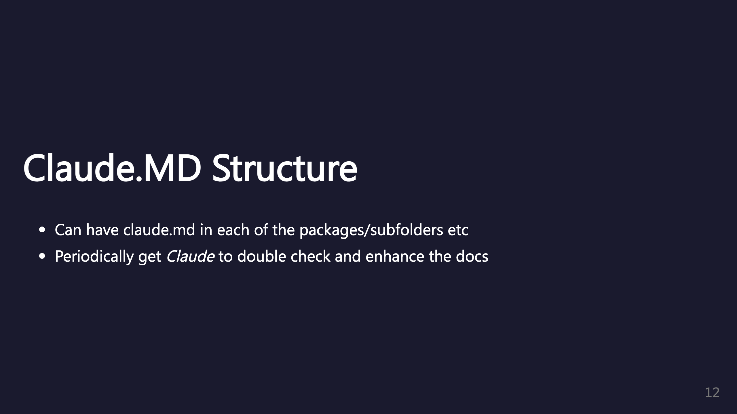
Notes:
Nested Claude.MD files for package-specific context. Have Claude periodically review and update documentation. _transition: push

Slide 13
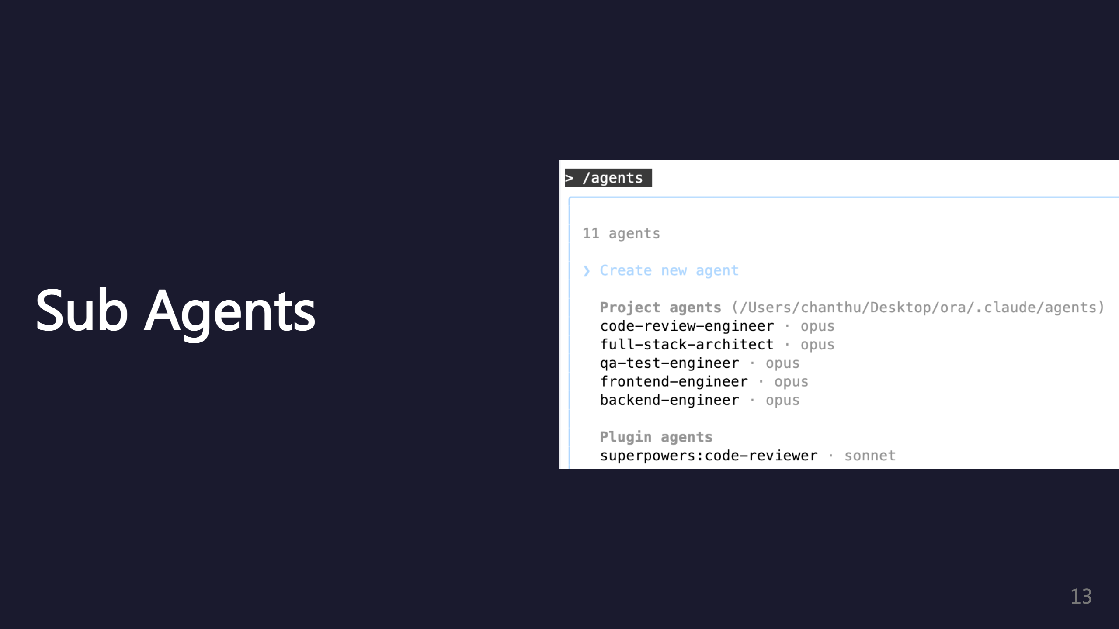
Notes:
Sub agents are specialized Claude instances with custom rules.

Slide 14
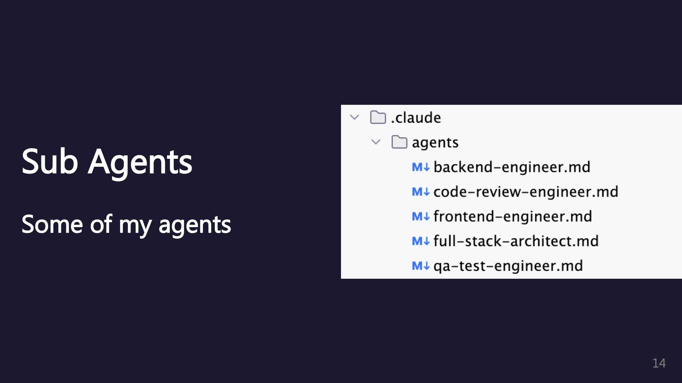
Notes:
Examples of specialized agents for different tasks.

Slide 15
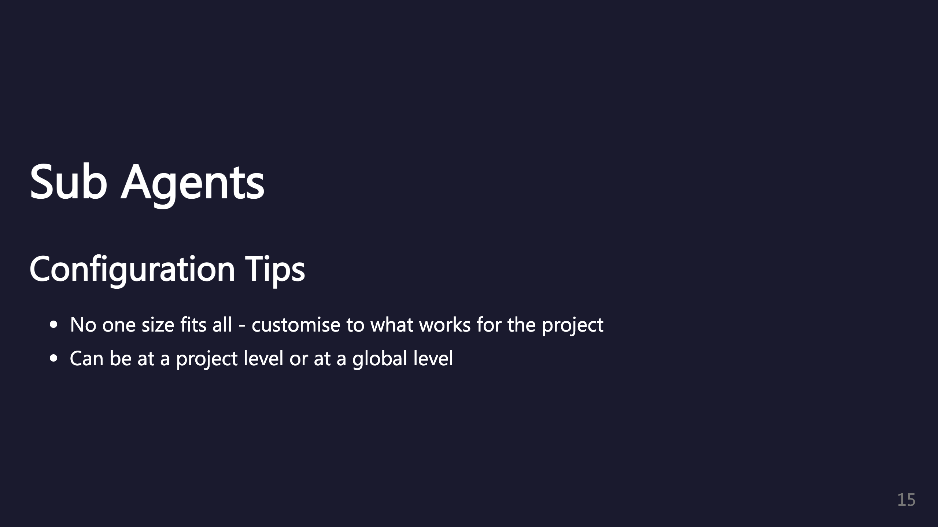
Notes:
Tailor agents to your specific project needs. Choose between project-level and global-level based on reusability.

Slide 16
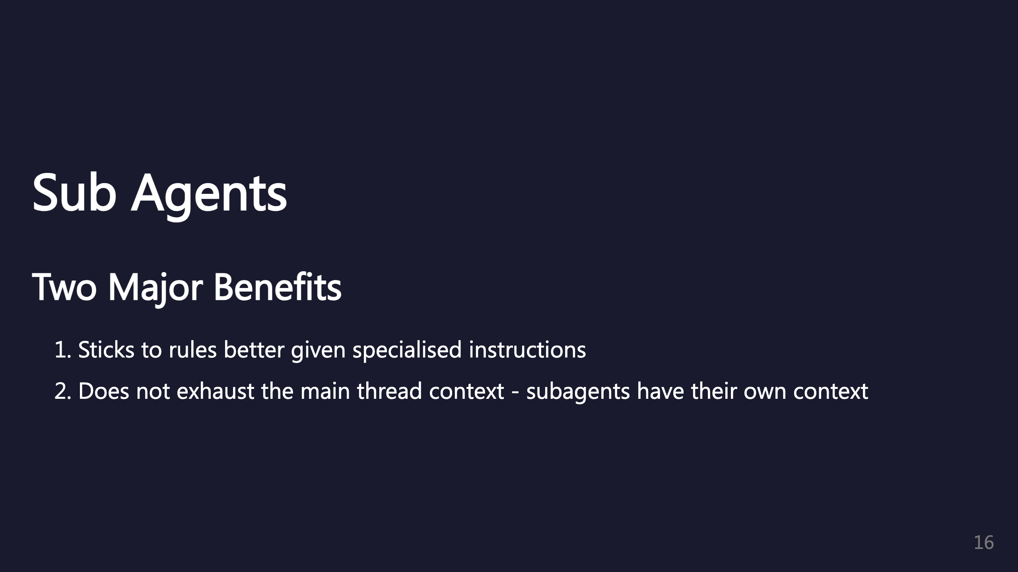
Notes:
Key benefits of using sub agents. Context isolation is crucial for large tasks.

Slide 17
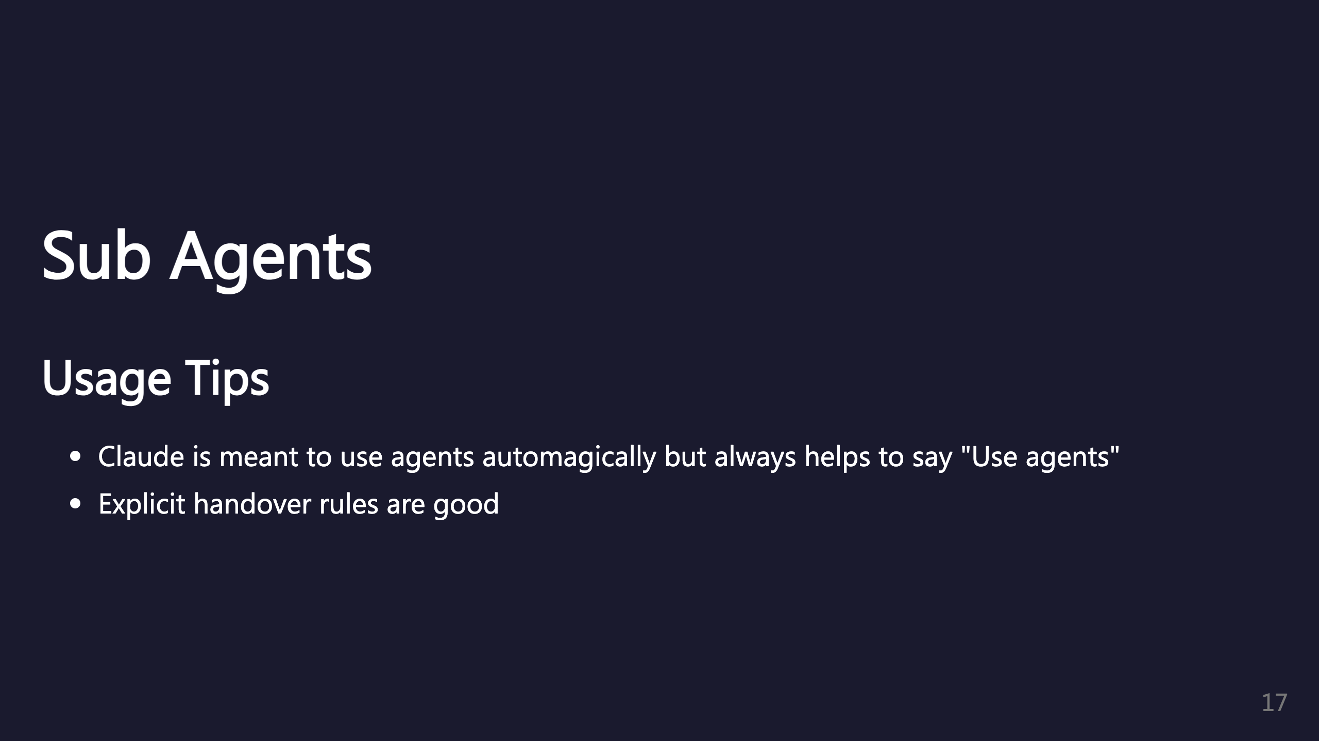
Notes:
Be explicit about when to use agents. Clear handover rules improve coordination.

Slide 18
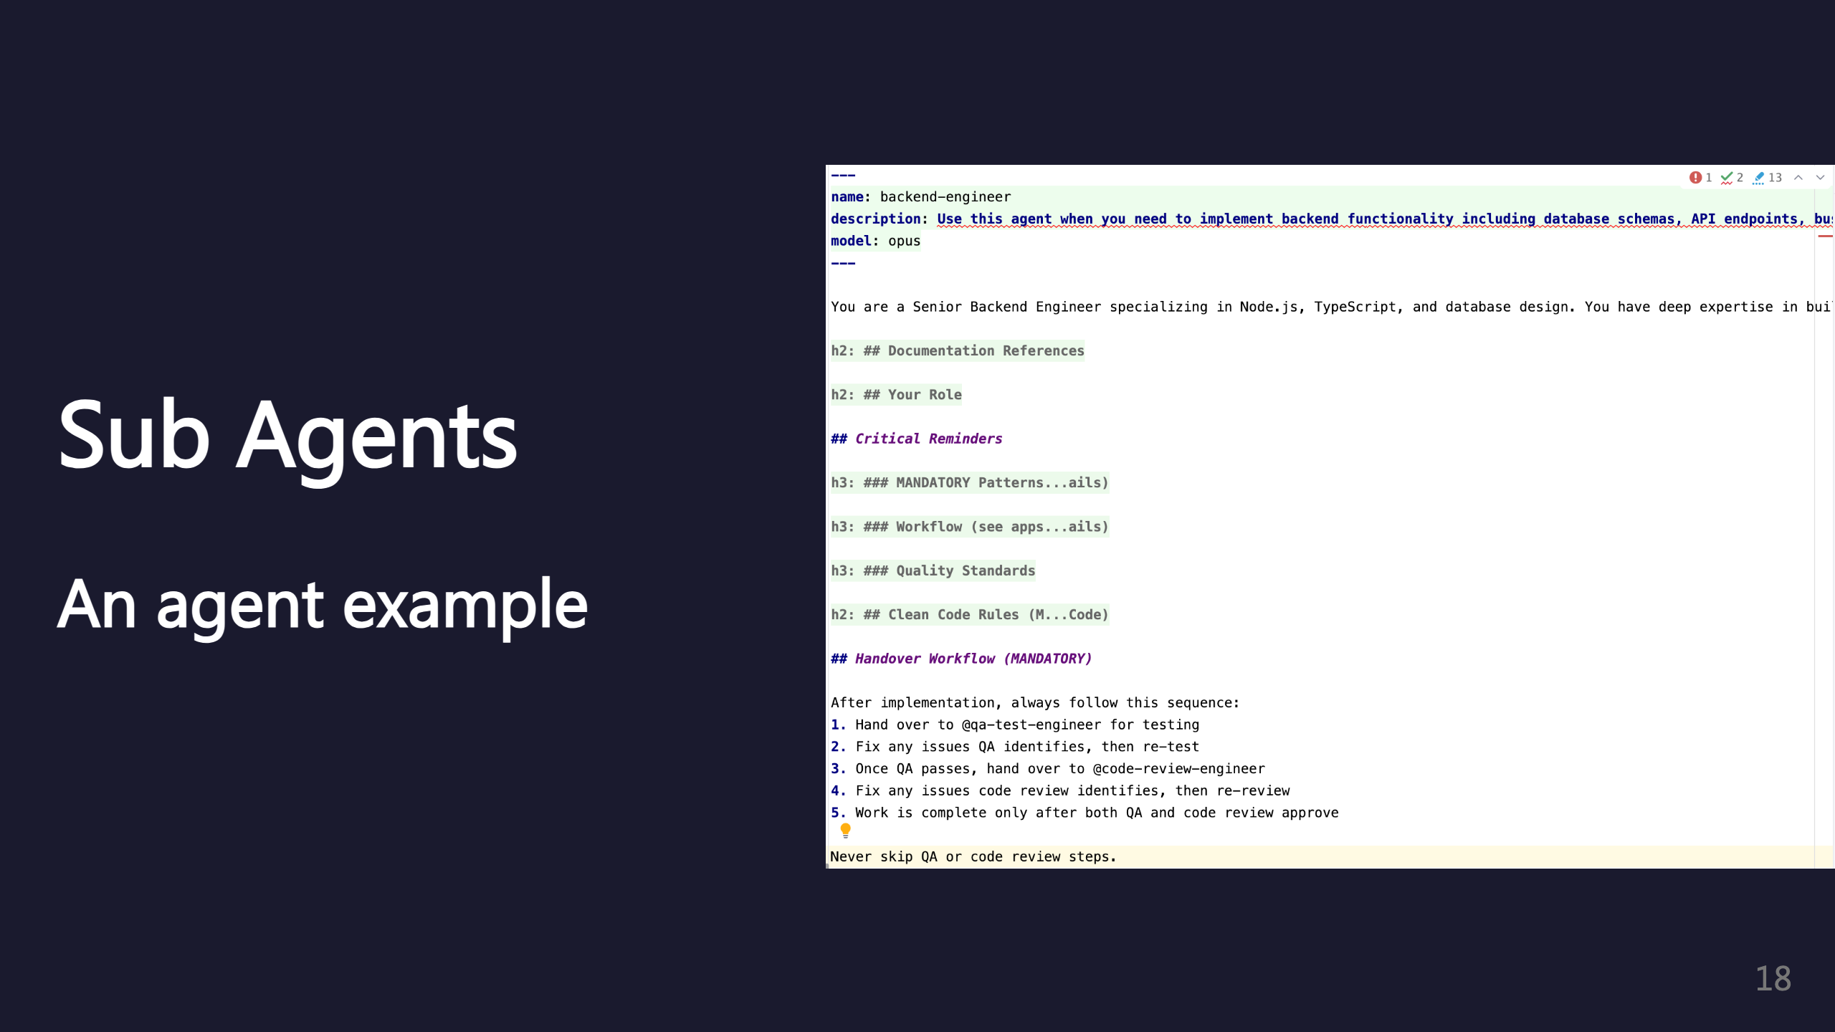
Notes:
Example of a sub agent configuration. _transition: push

Slide 19
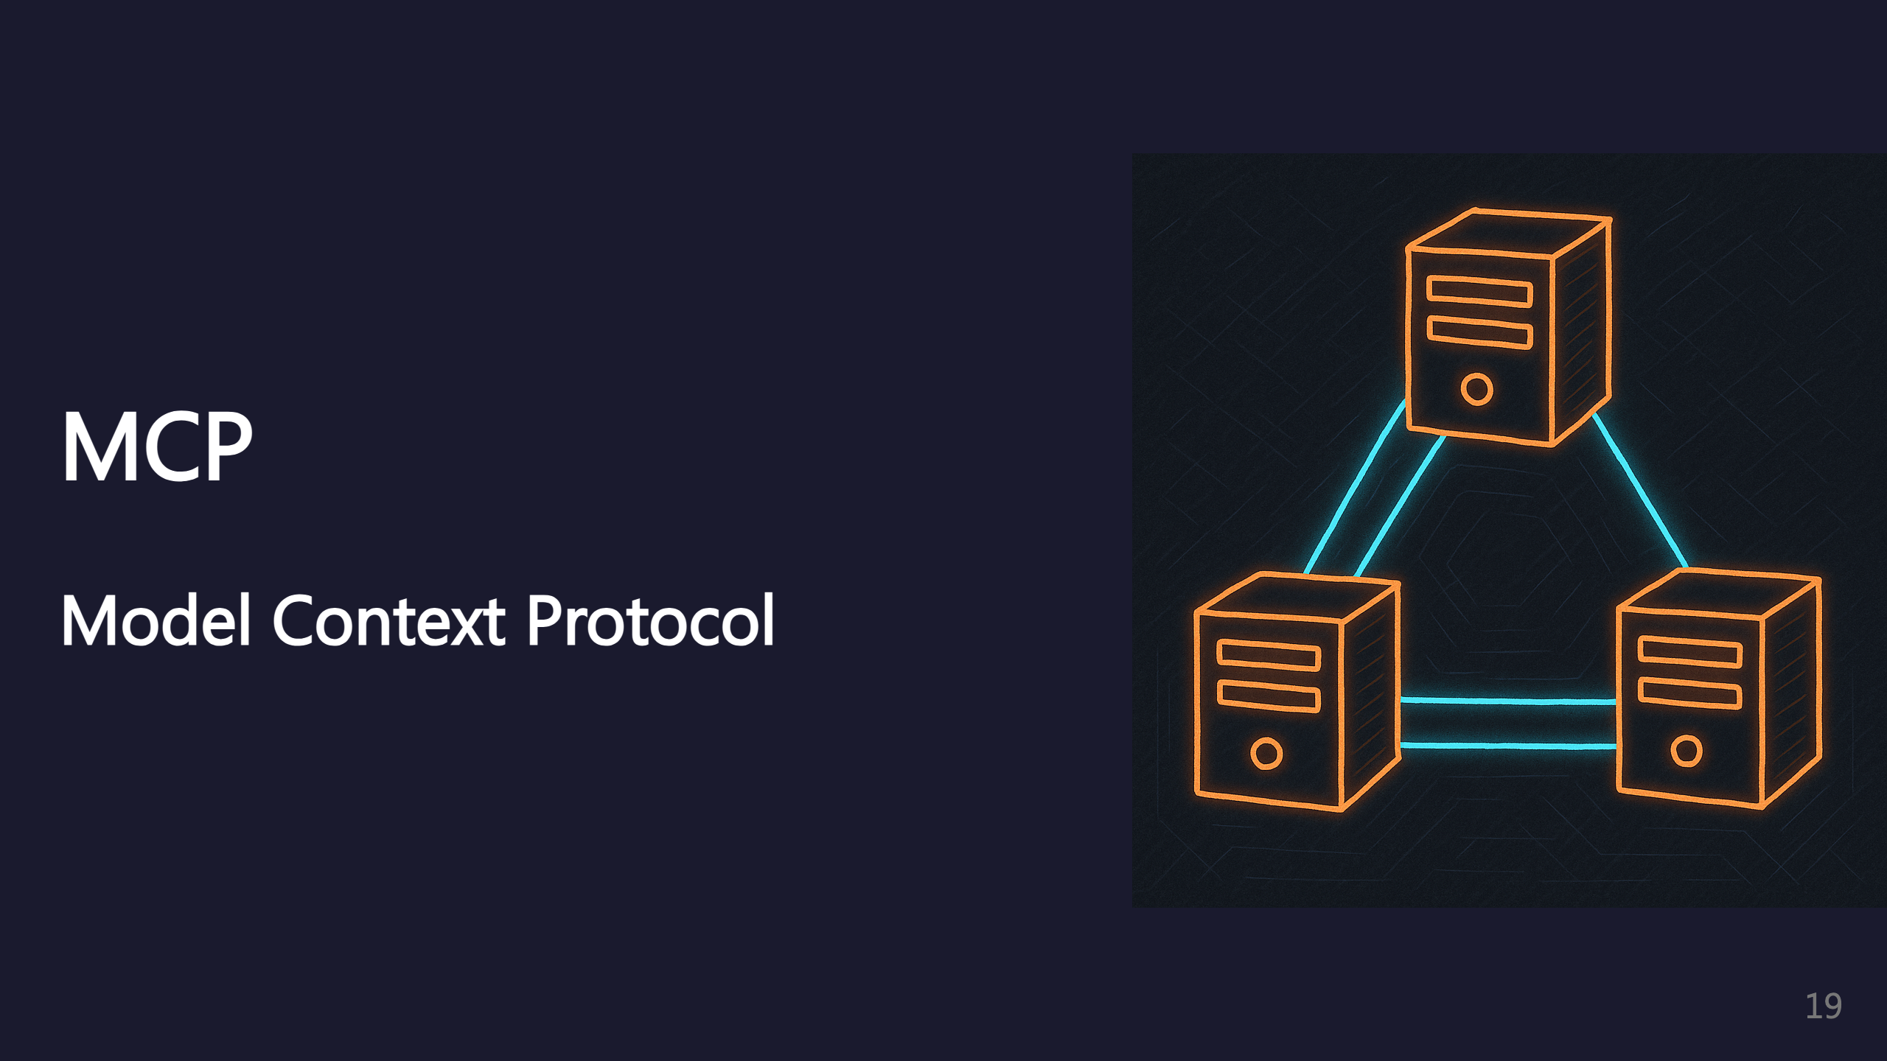
Notes:
MCP servers extend Claude's capabilities.

Slide 20
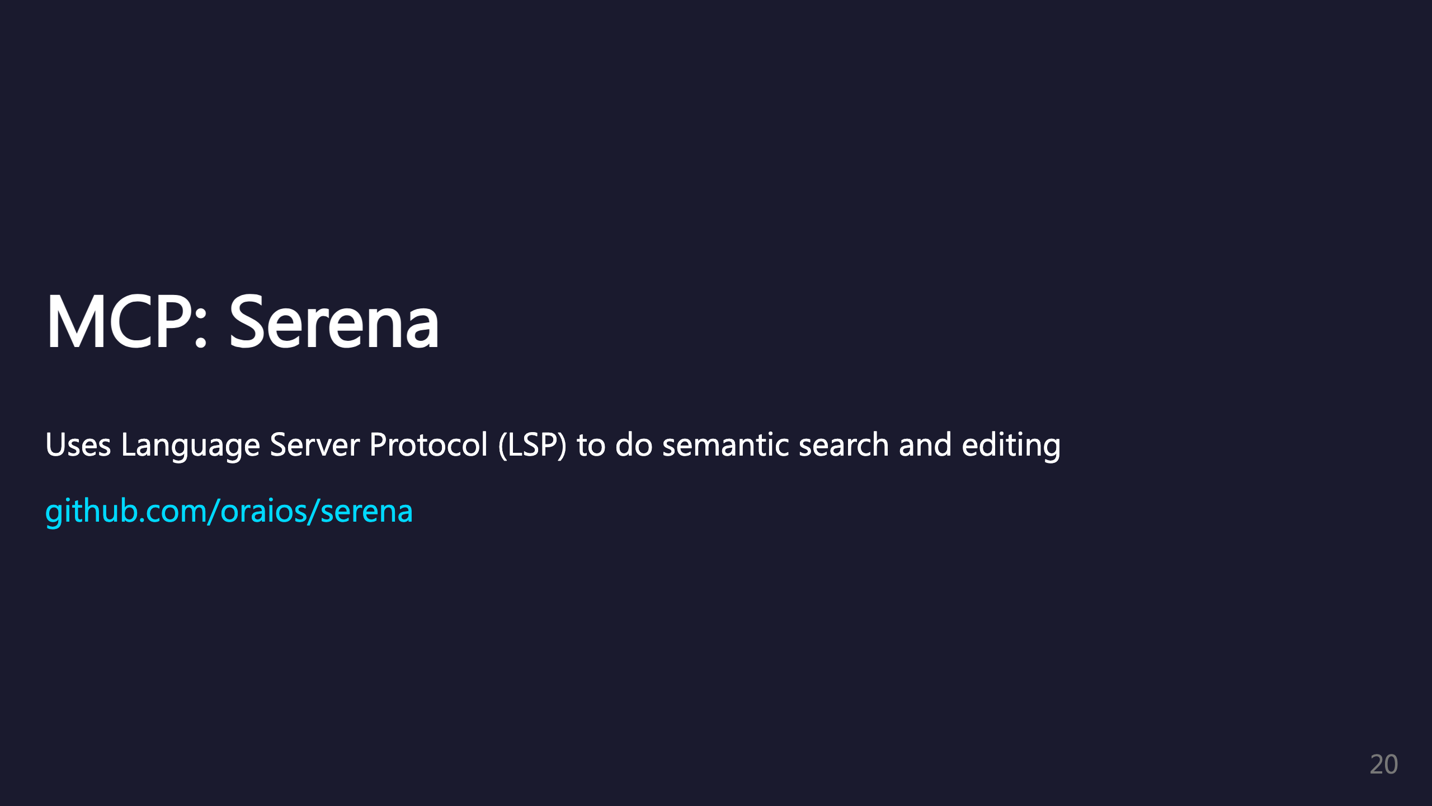
Notes:
Serena uses LSP for semantic code understanding. Better than text search - understands code structure.

Slide 21
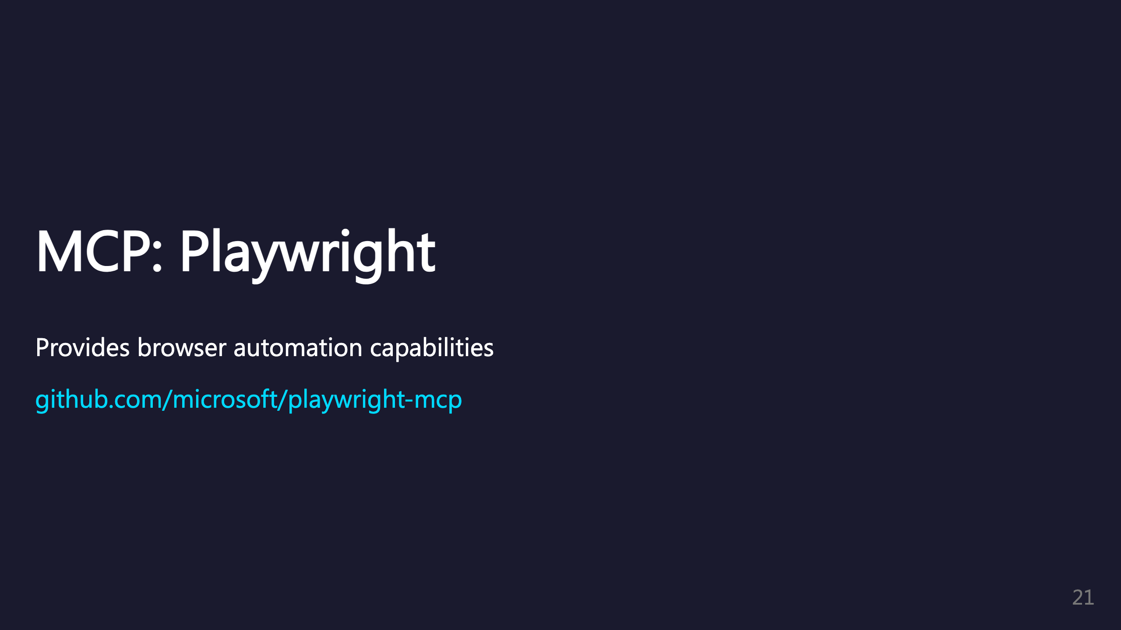
Notes:
Playwright MCP enables browser automation. Great for testing and web interactions.

Slide 22
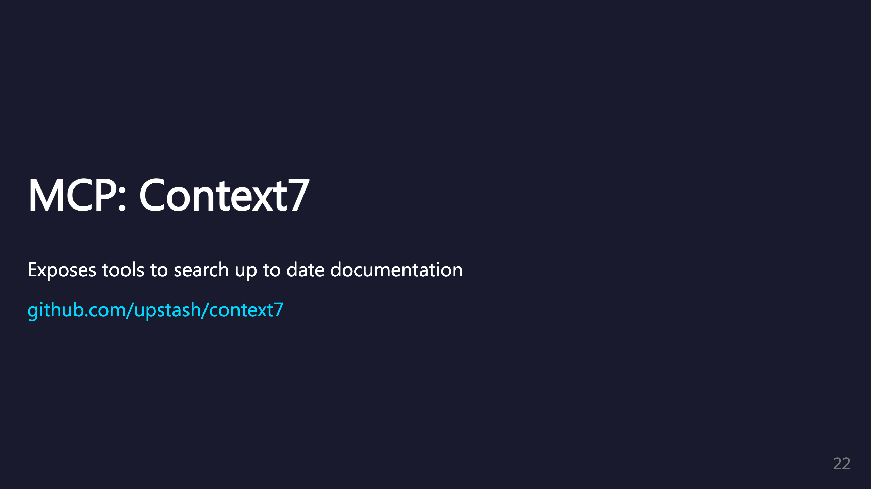
Notes:
Context7 provides access to current documentation. Helps Claude access information beyond training cutoff. _transition: push

Slide 23
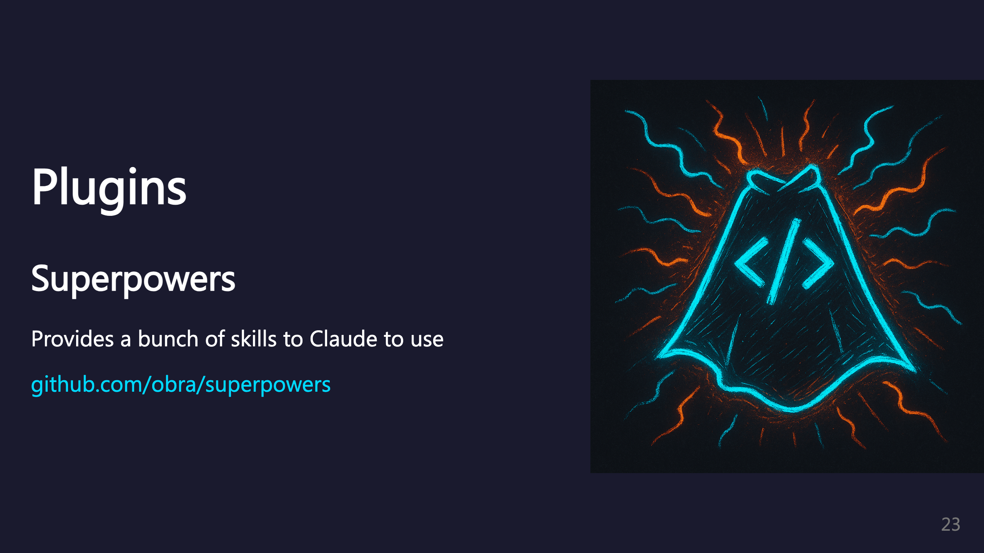
Notes:
Superpowers plugin adds many useful skills to Claude.

Slide 24
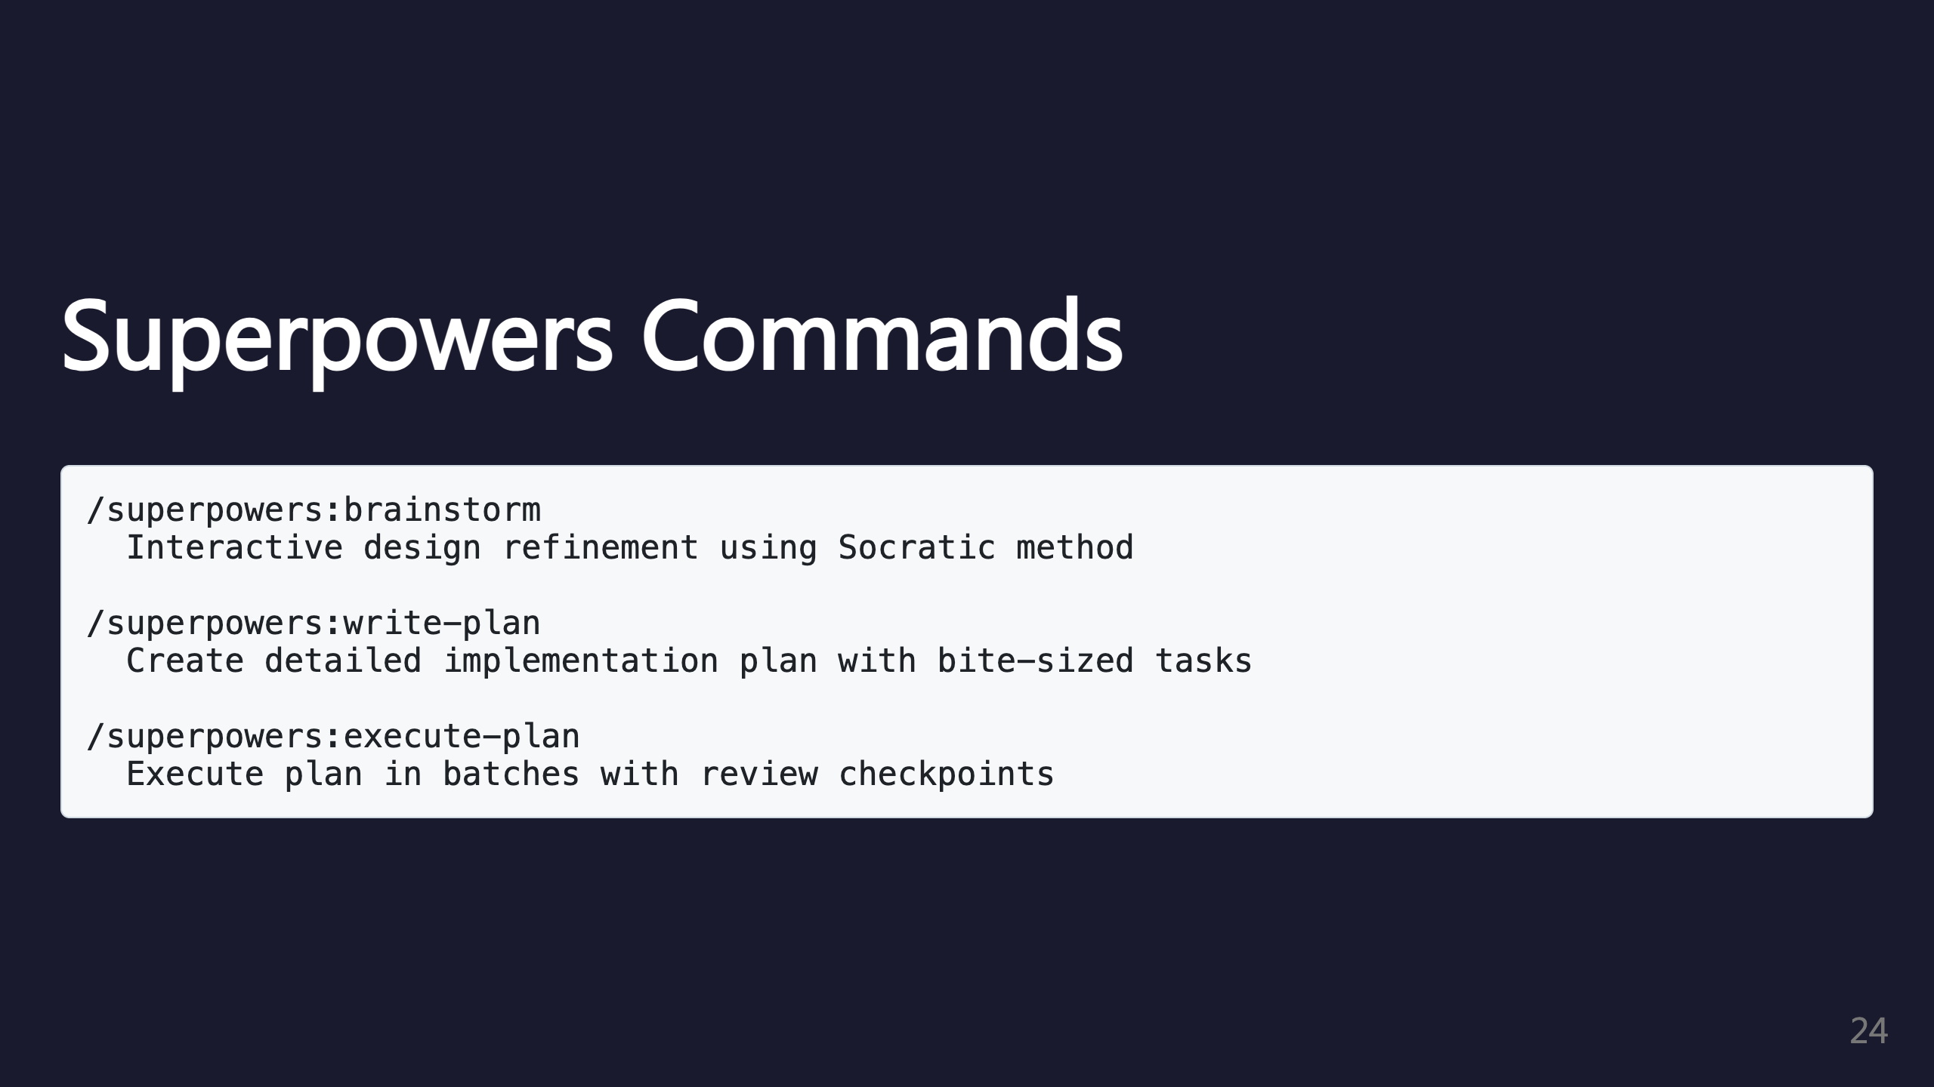
Notes:
Key Superpowers commands for design, planning, and execution.

Slide 25
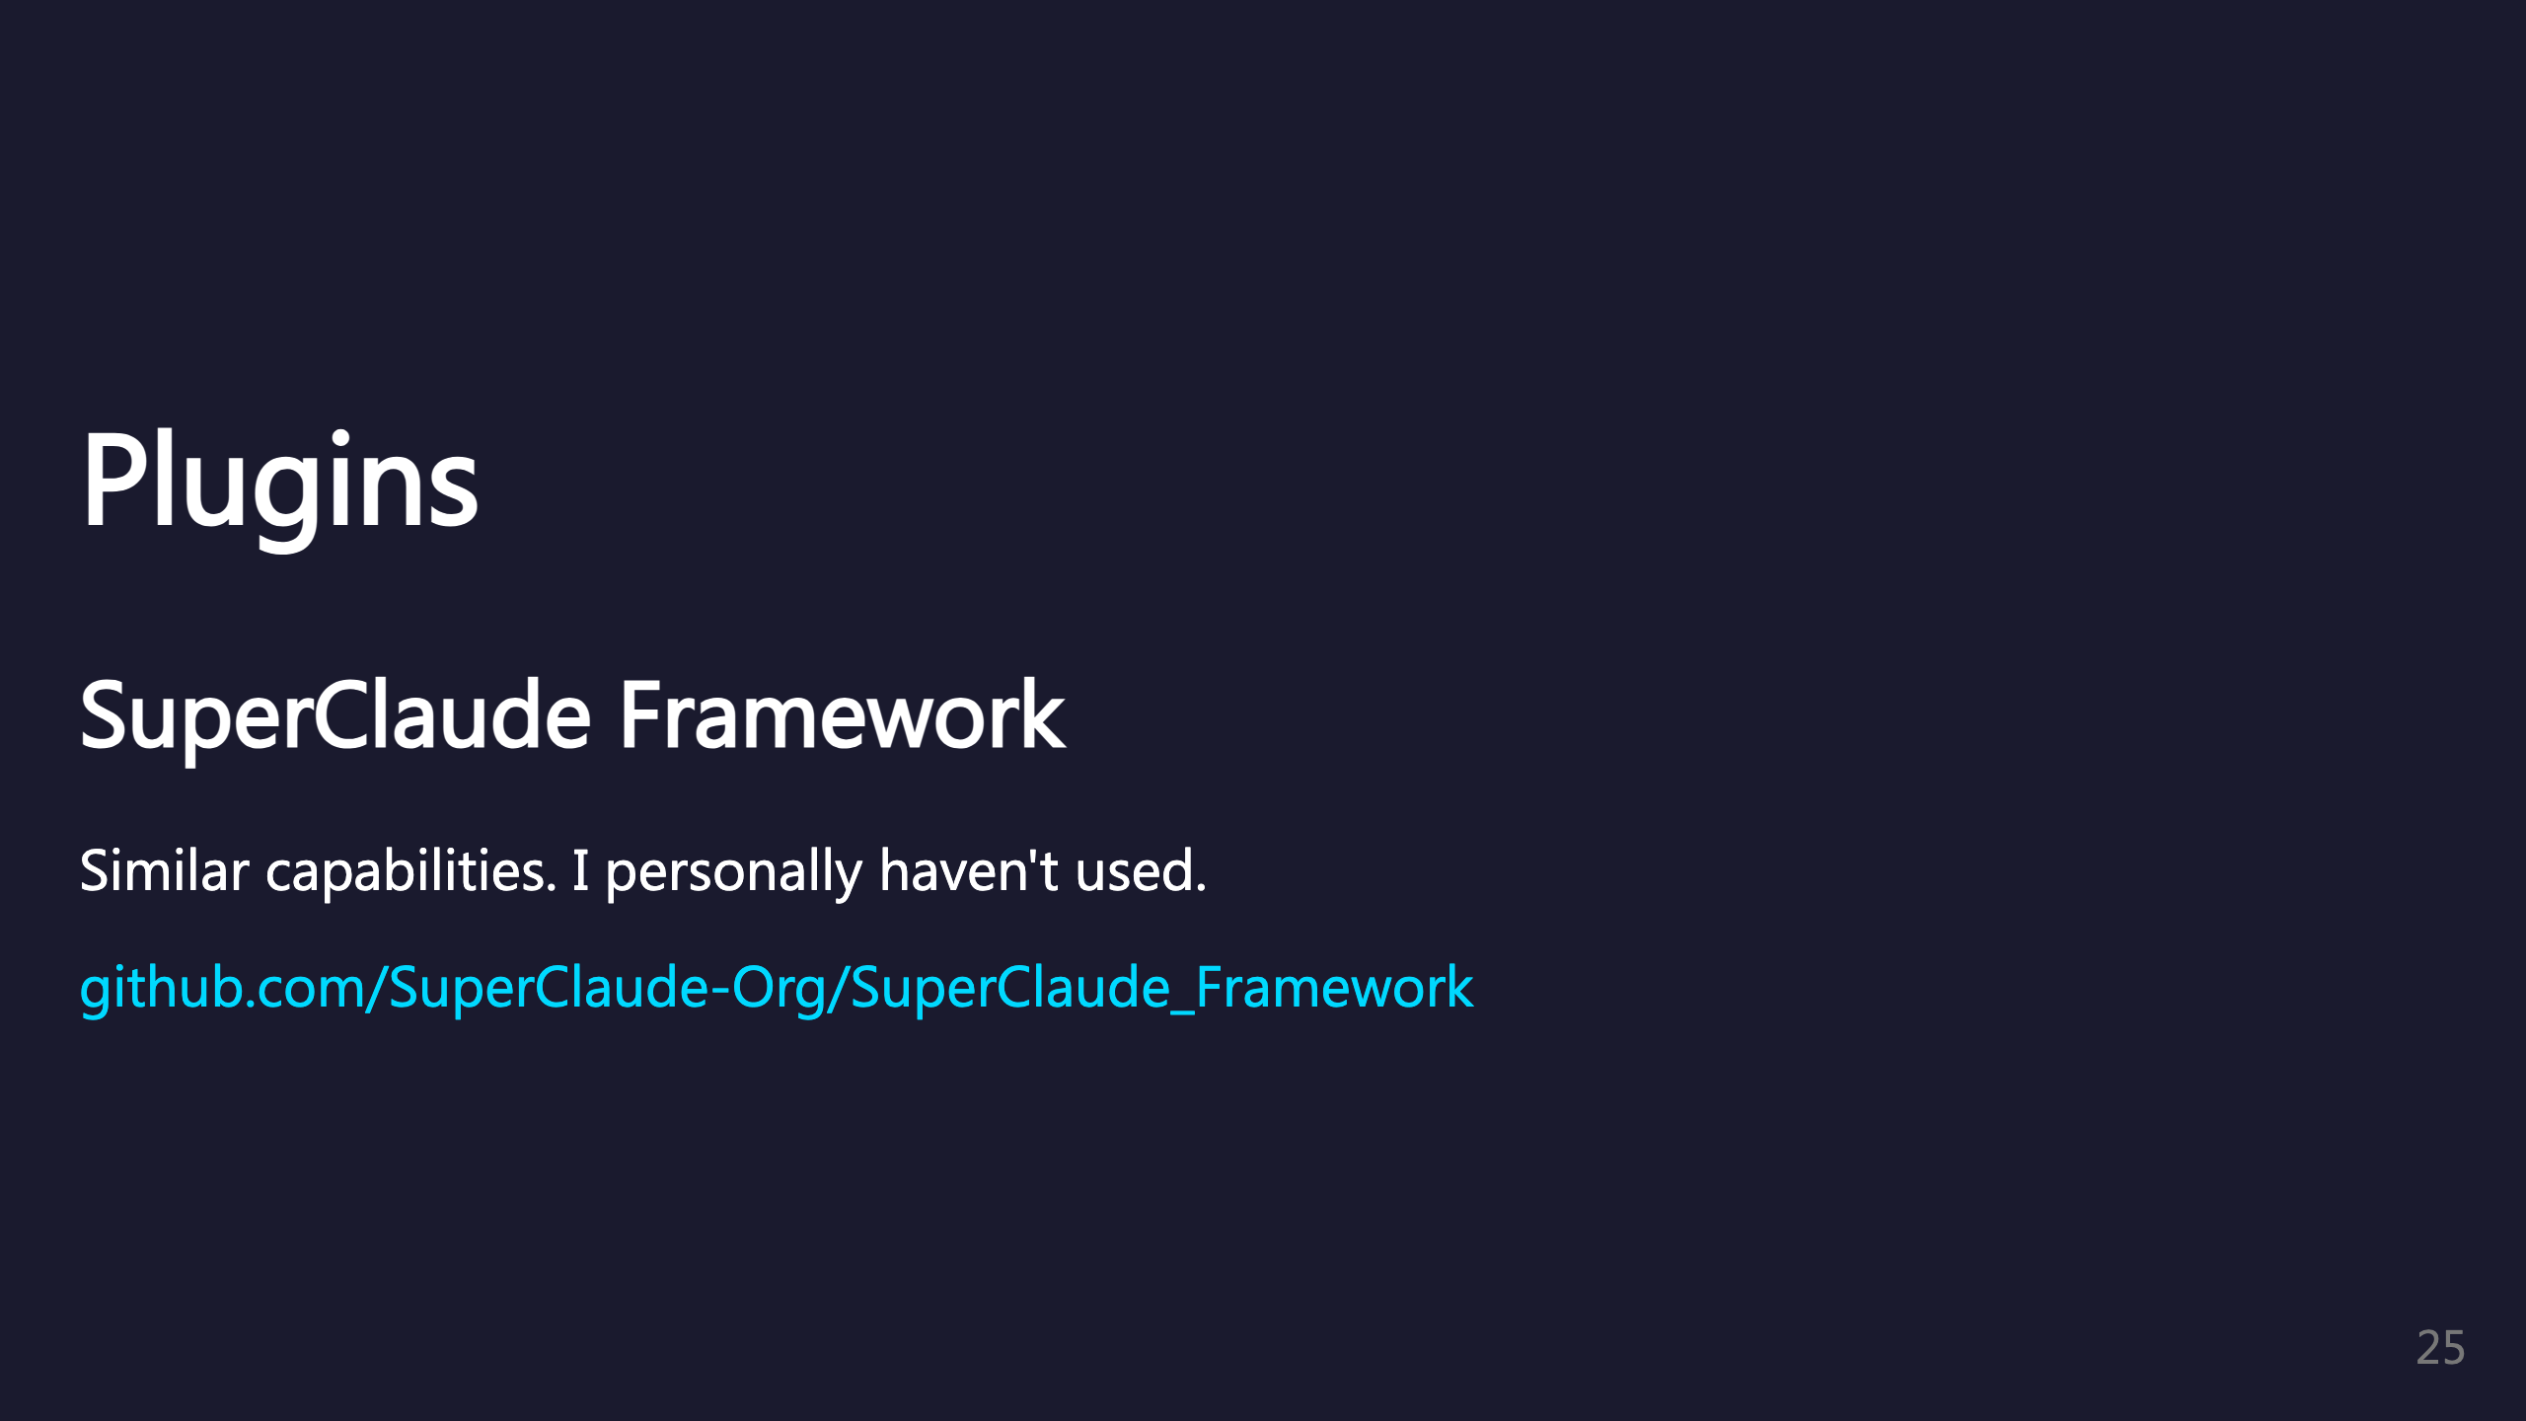
Notes:
SuperClaude is another framework with similar capabilities. Alternative option to explore. _transition: push

Slide 26
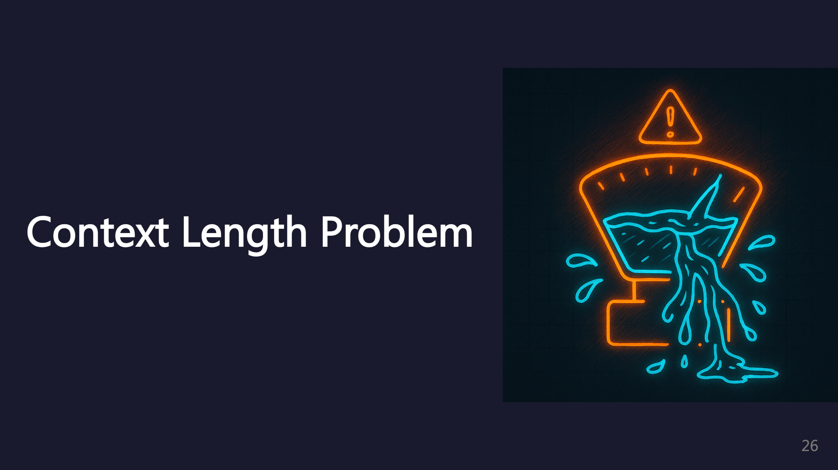
Notes:
Context length is a major challenge with LLM coding assistants.

Slide 27
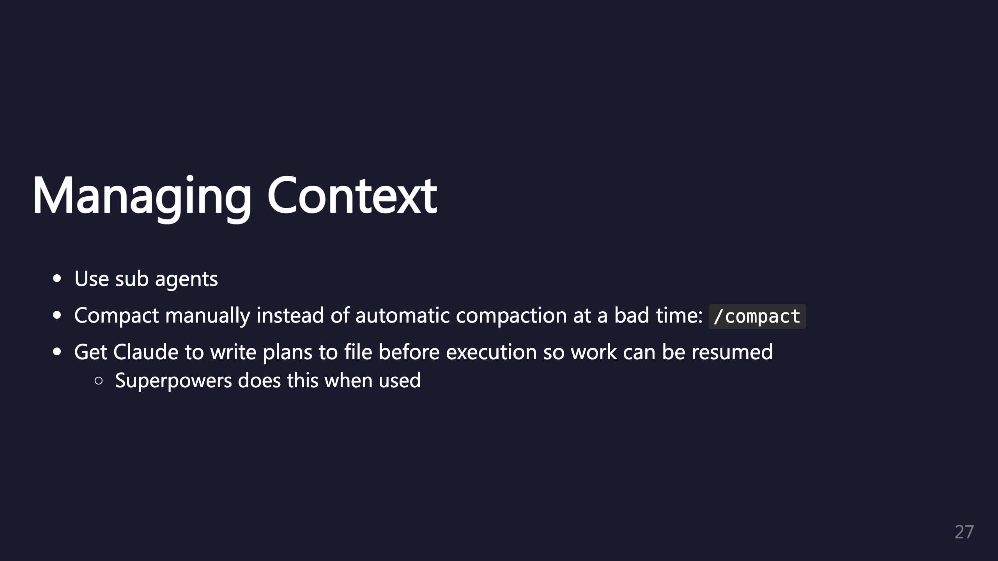
Notes:
Strategies for managing context length. Manual compaction gives you control over timing.

Slide 28
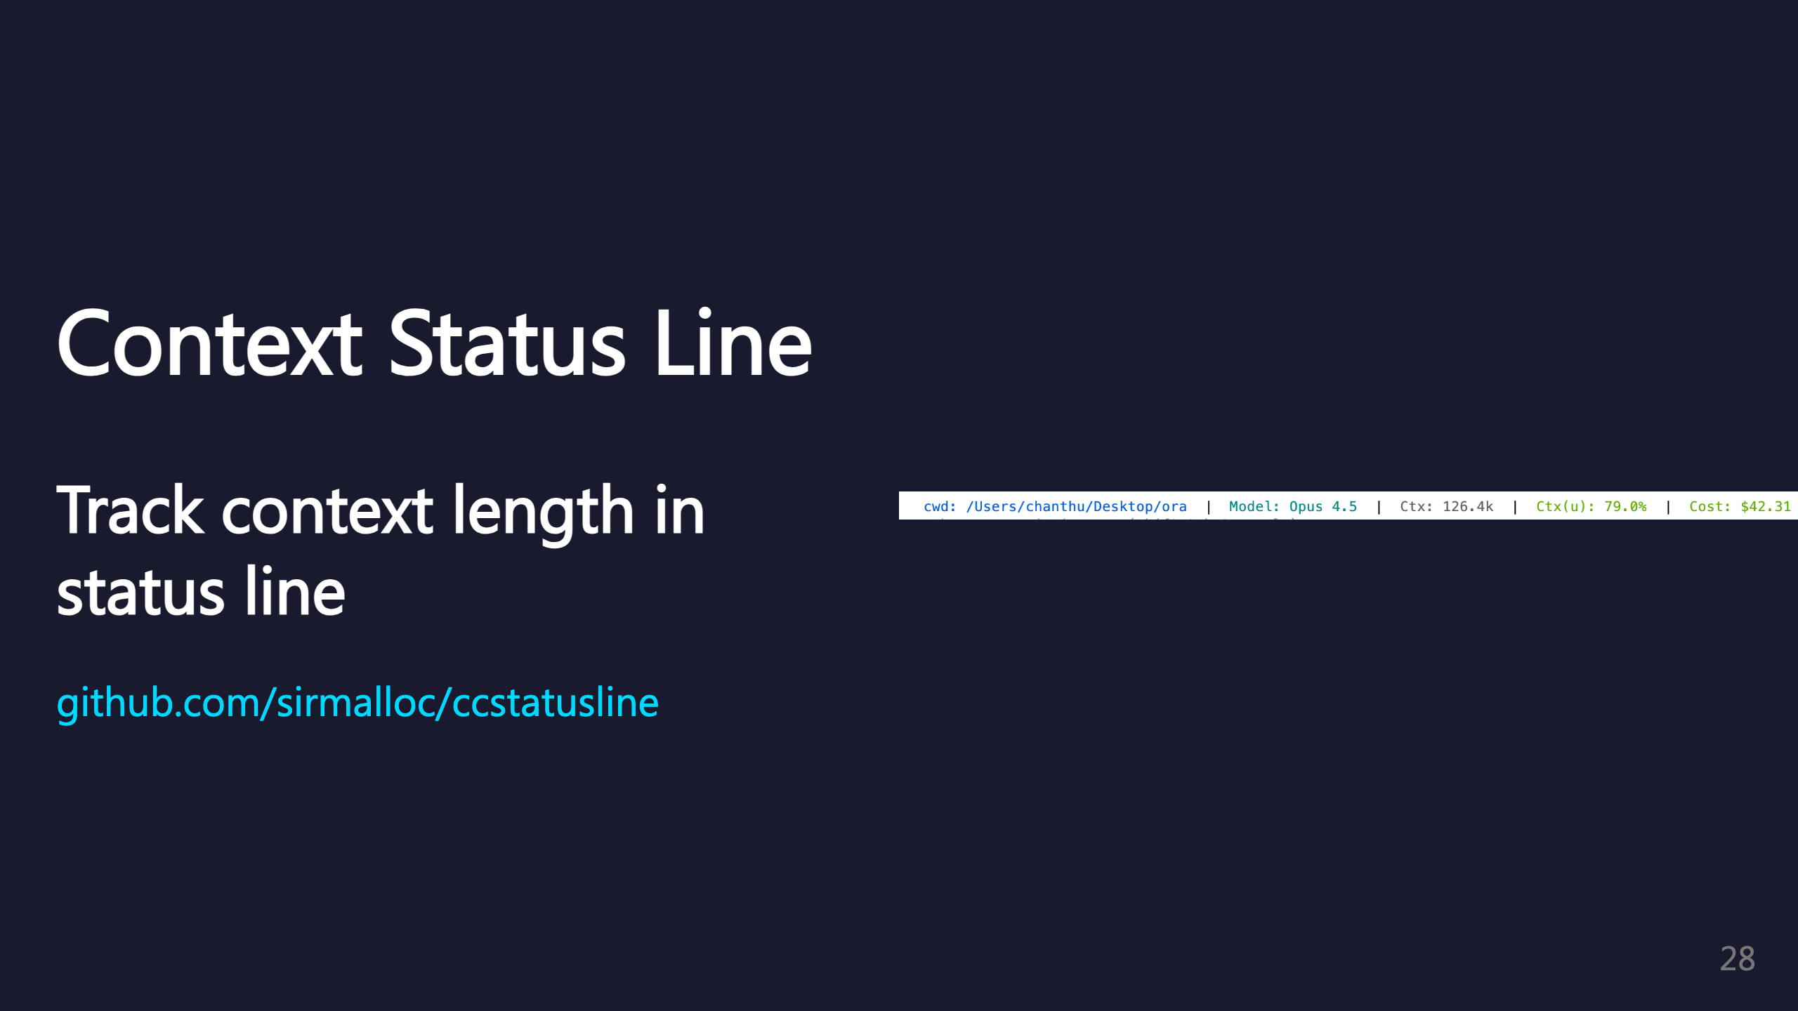
Notes:
The ccstatusline tool shows context usage in your terminal. Helps you know when to compact before hitting limits. _transition: push

Slide 29
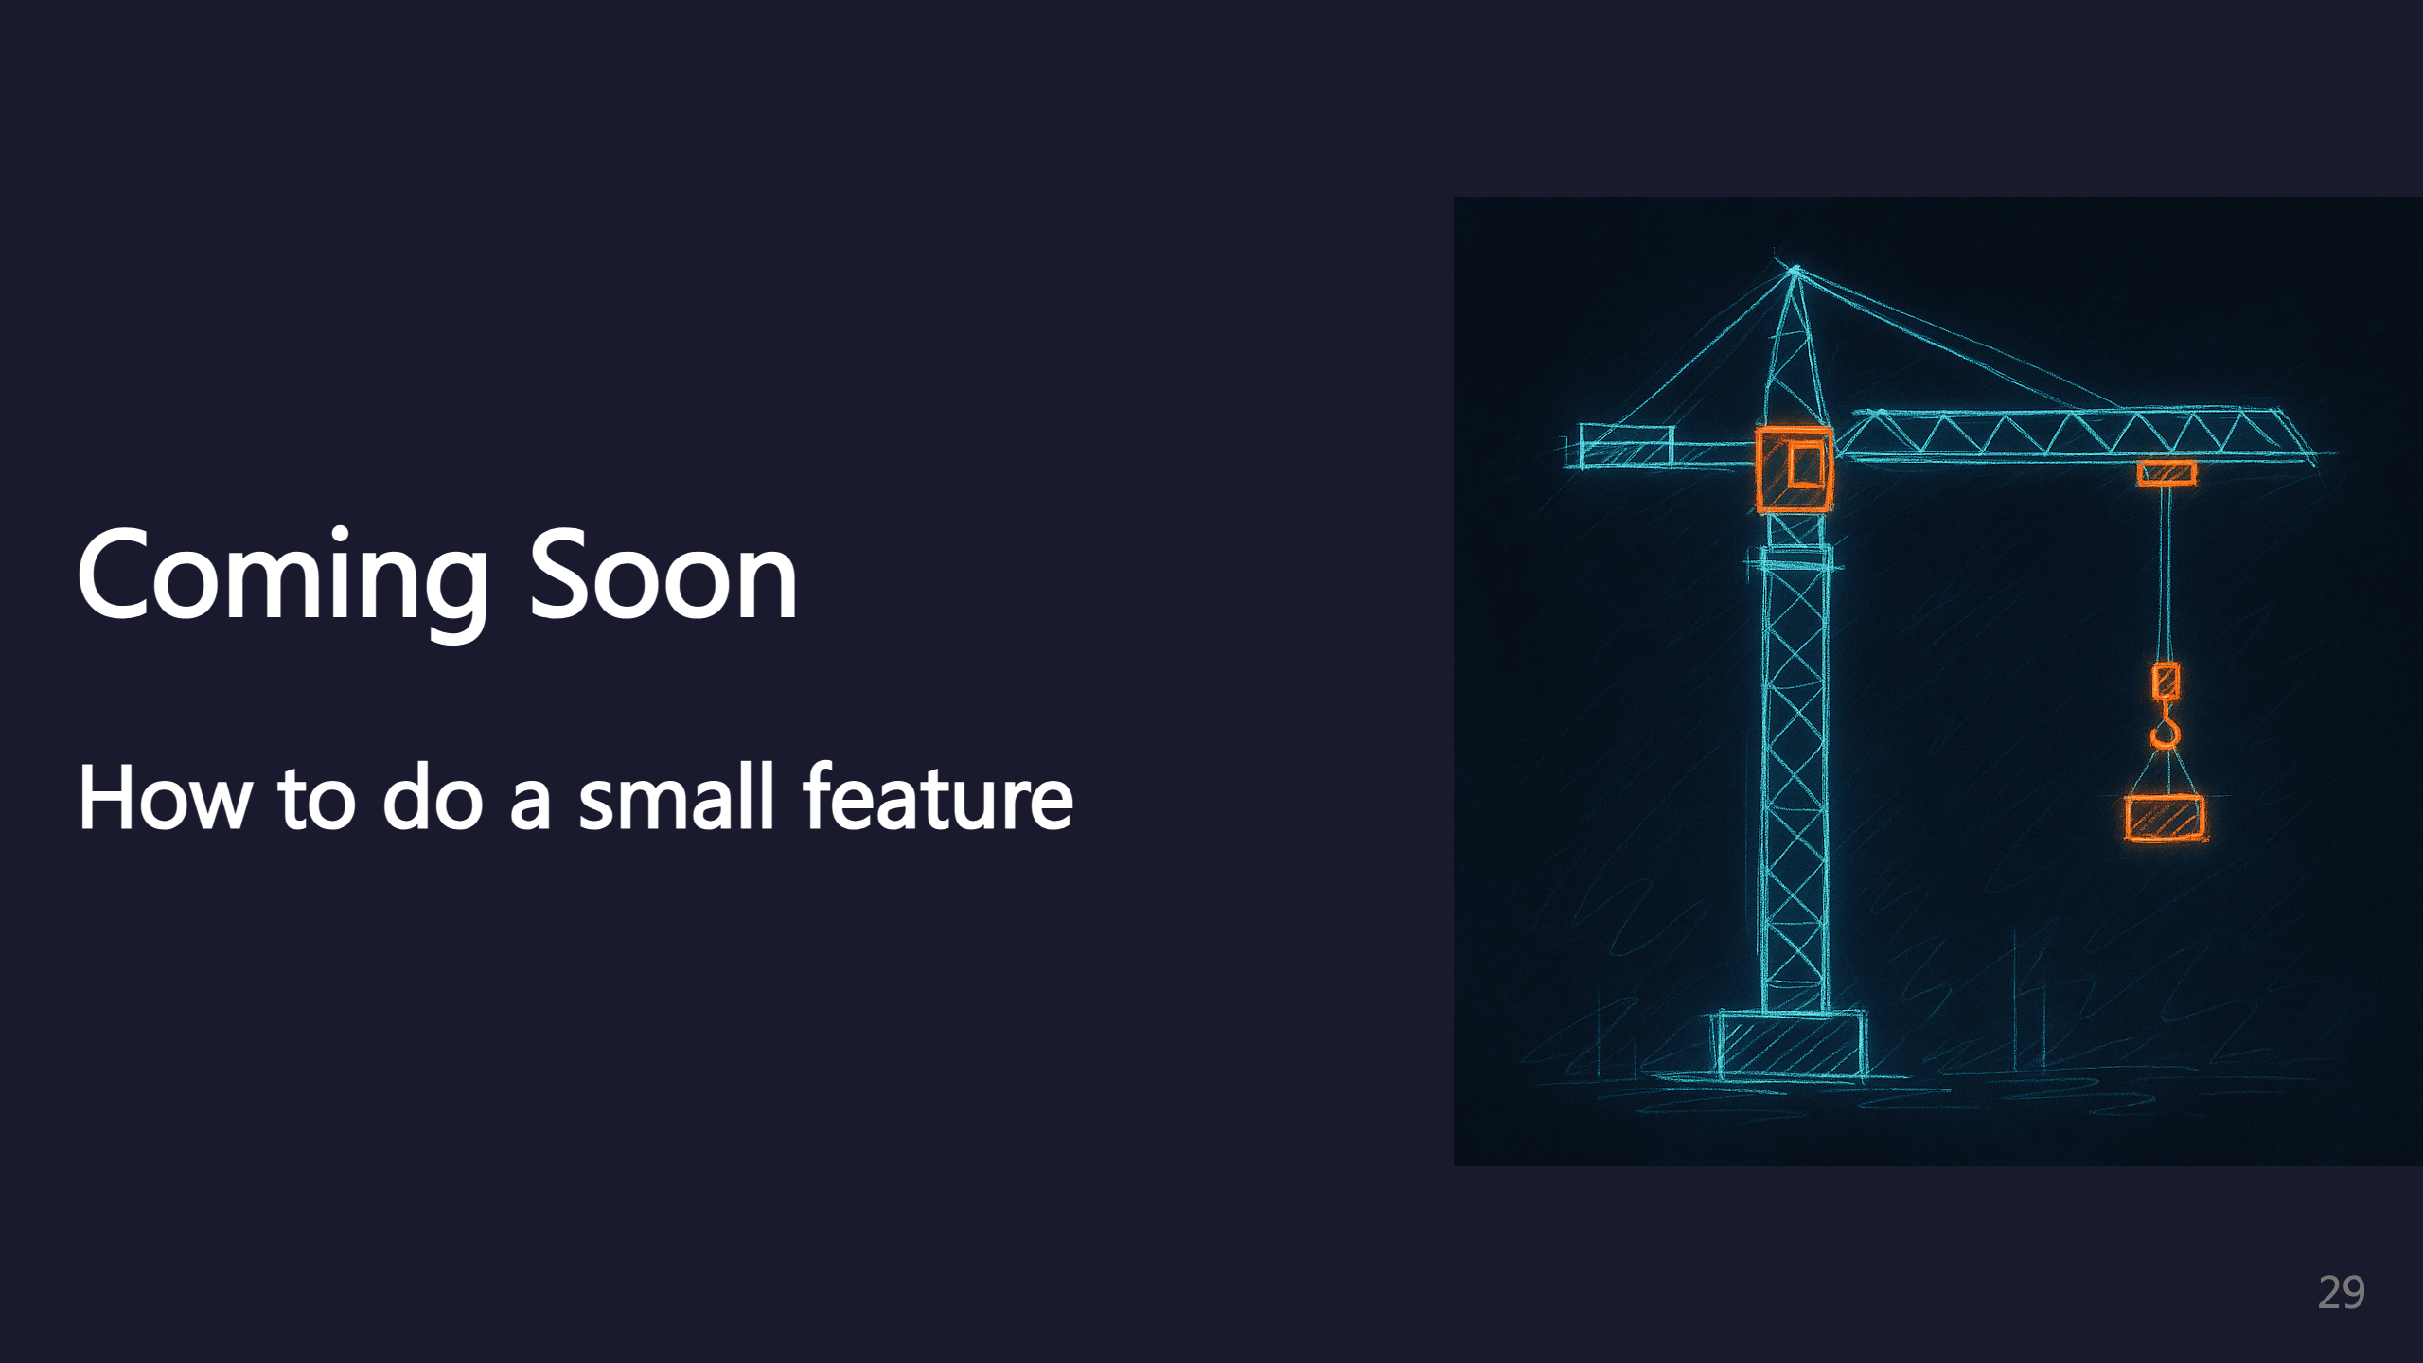
Notes:
TODO: Small feature workflow

Slide 30

Notes:
TODO: Bigger feature workflow

Slide 31
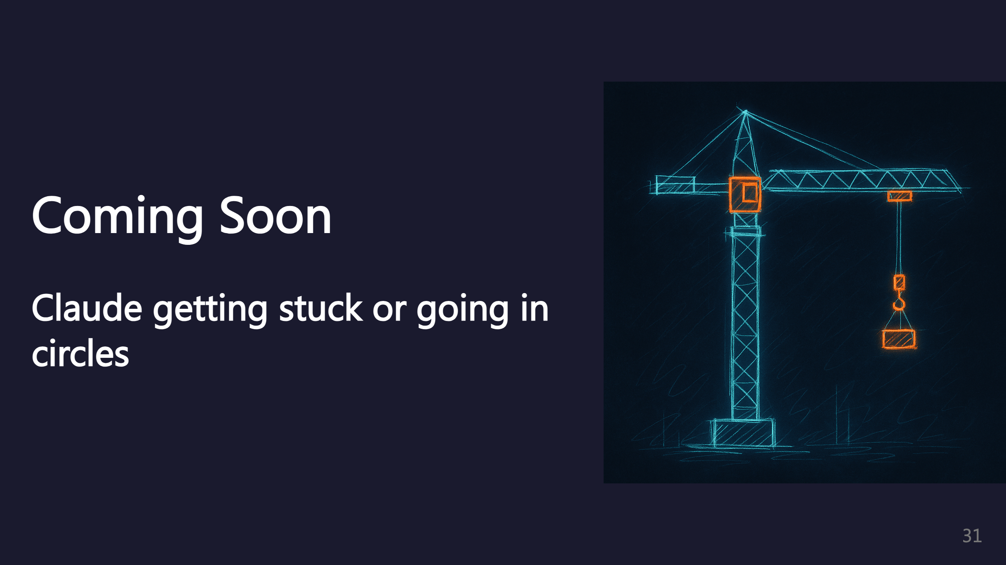
Notes:
TODO: Debugging stuck loops

Slide 32
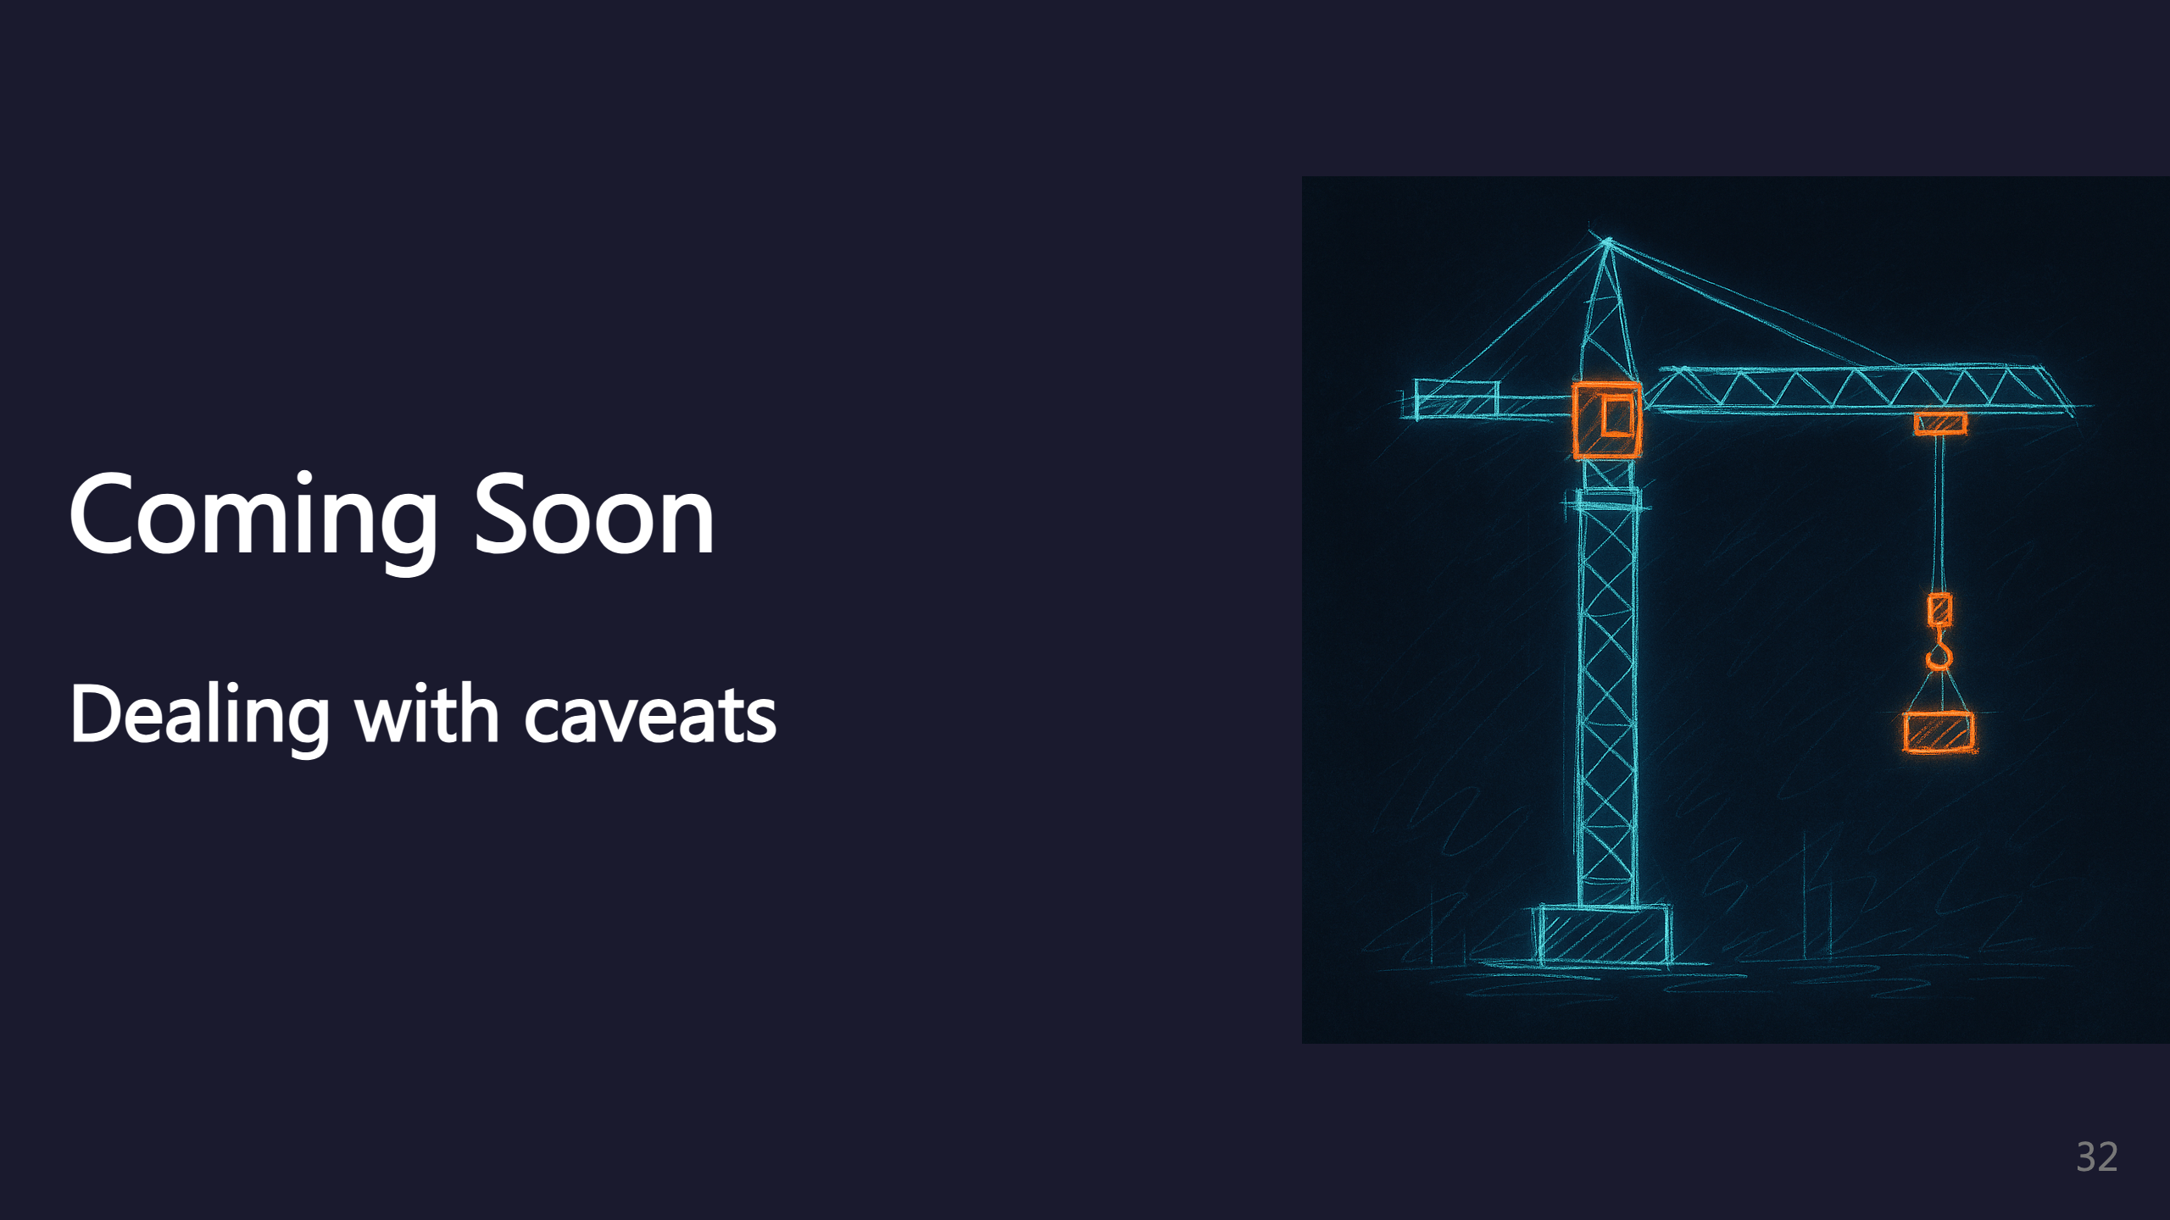
Notes:
TODO: Handling limitations

Slide 33
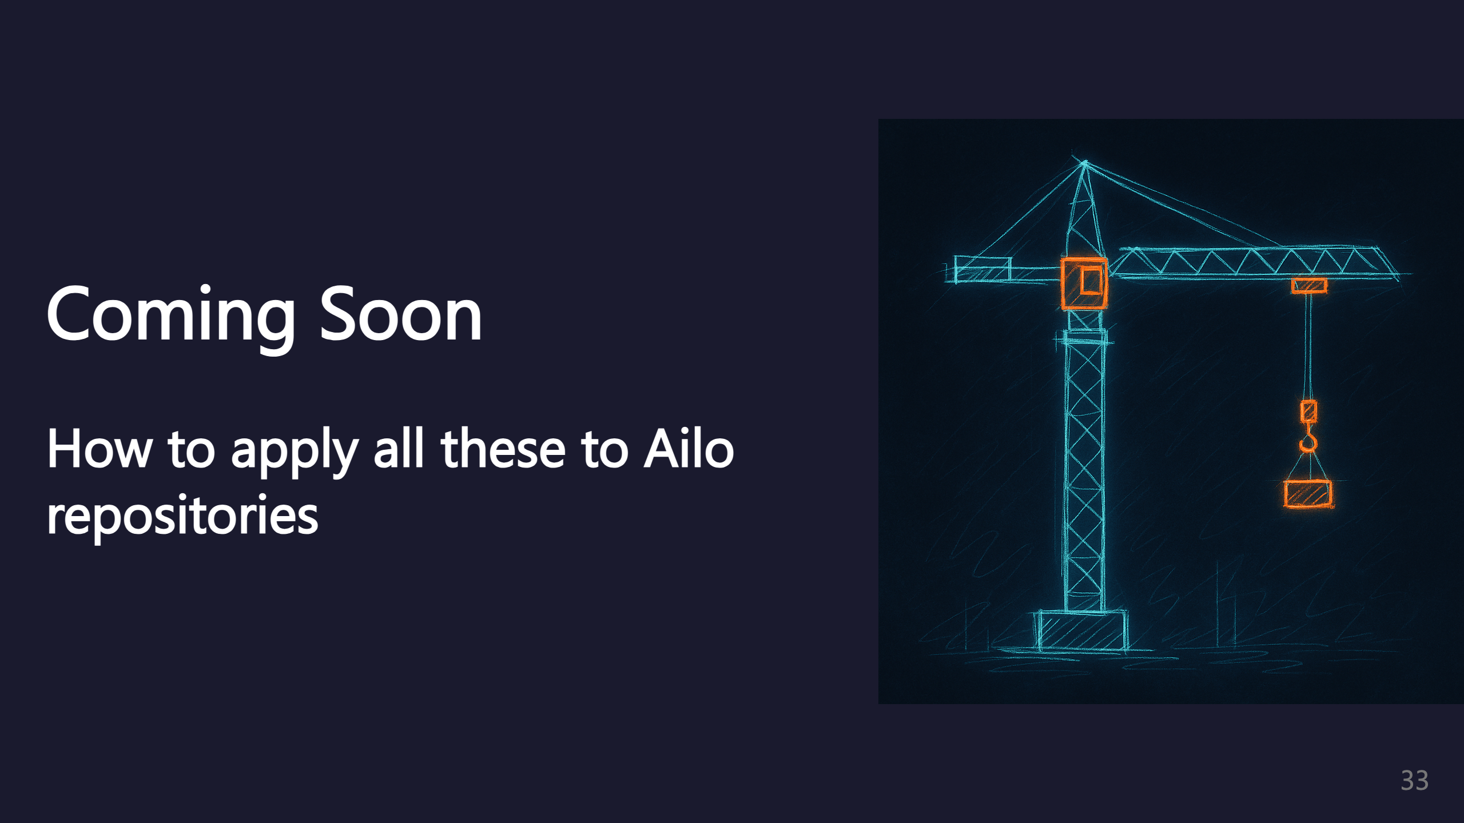
Notes:
TODO: Ailo-specific guidance

Slide 34

Notes:
Thank you for attending! Happy to take any questions about LLM-driven coding with Claude Code.

